Slide 1
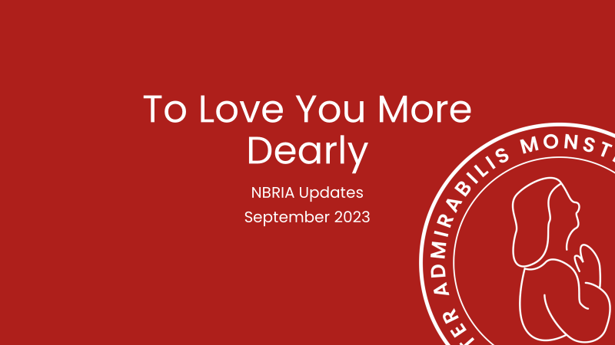

Slide 2
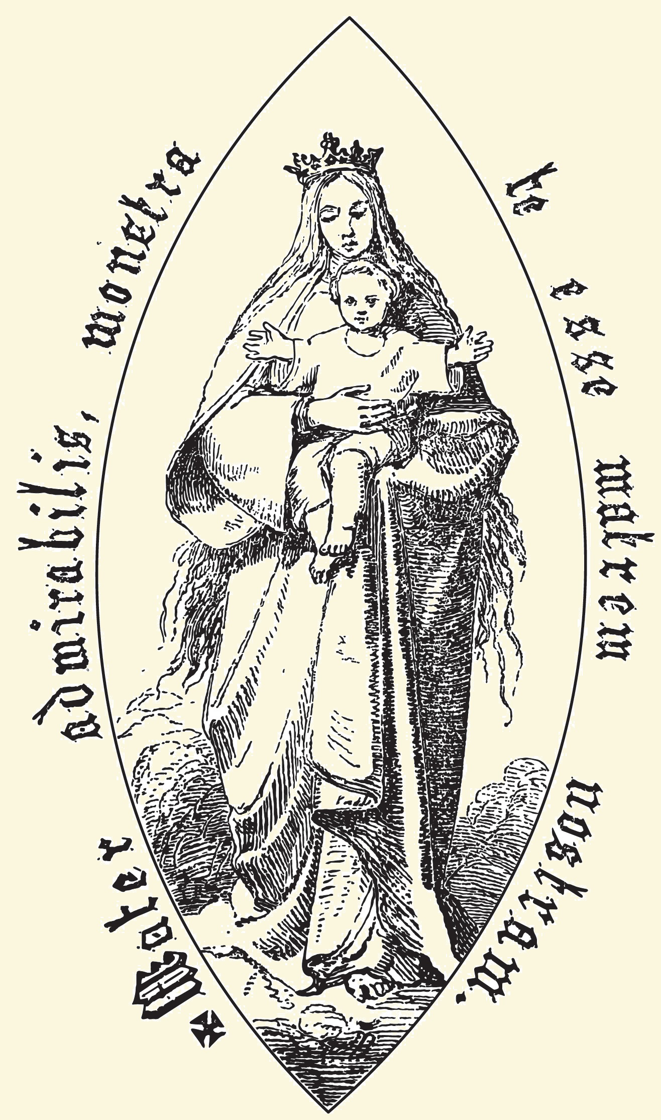
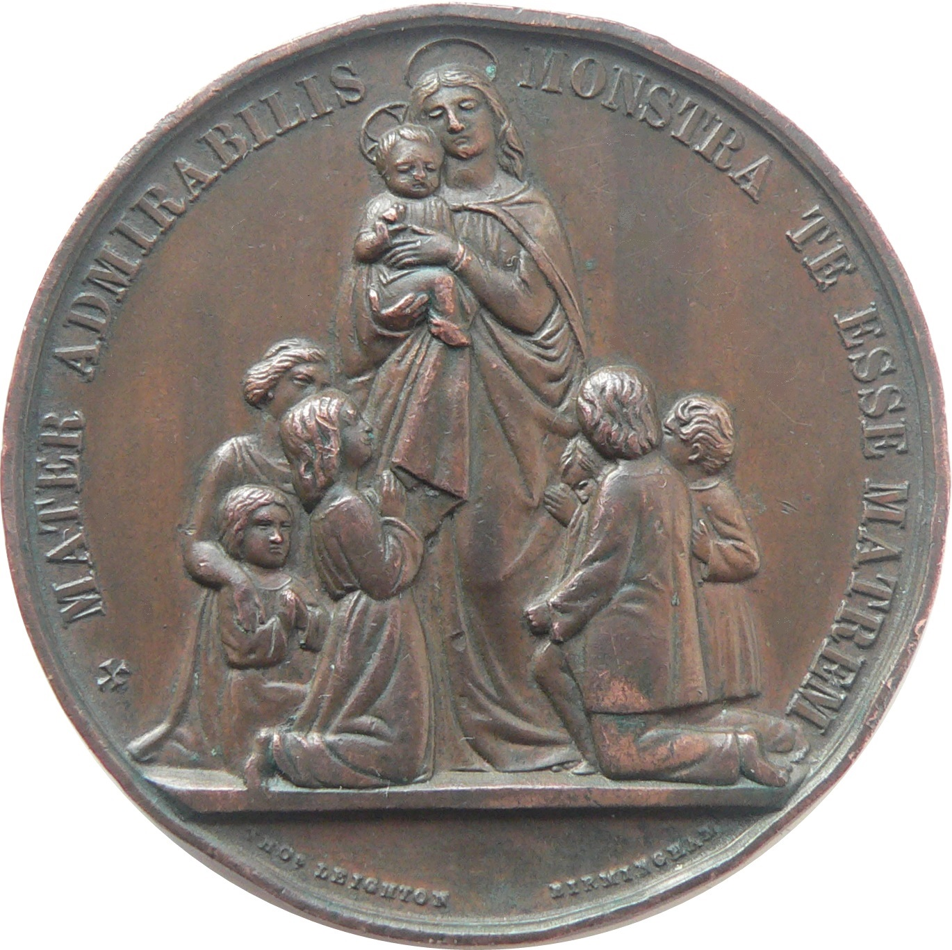
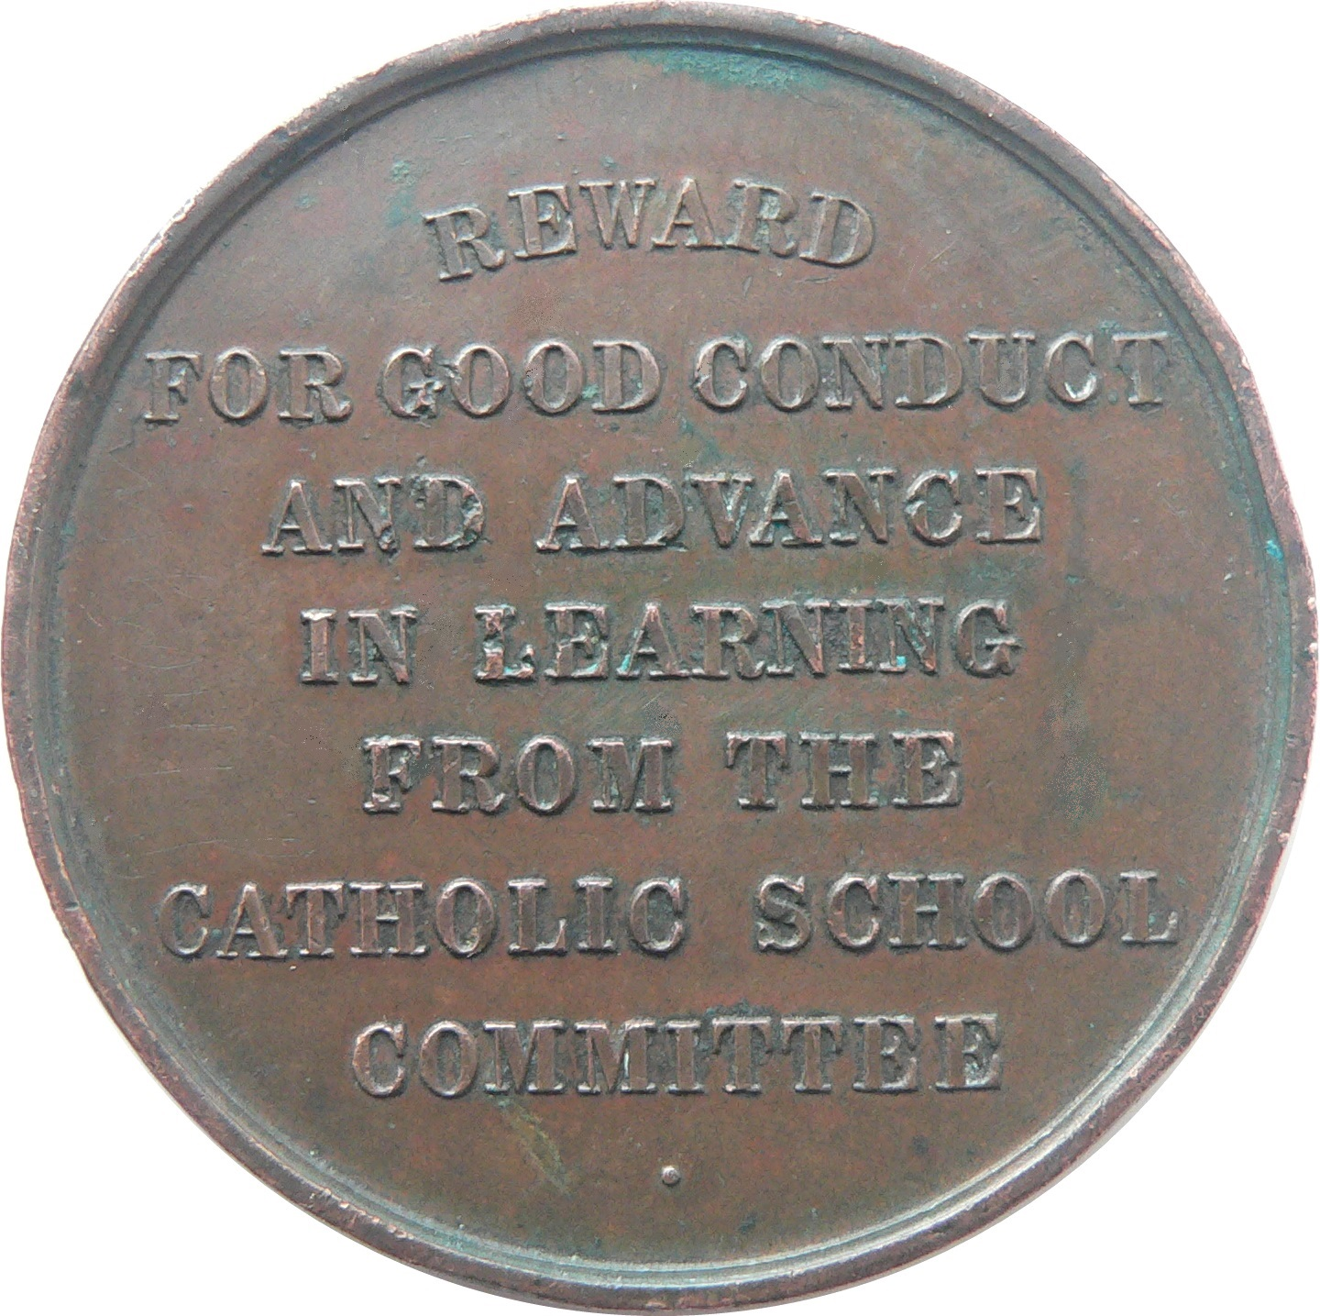
Introduction

Slide 3
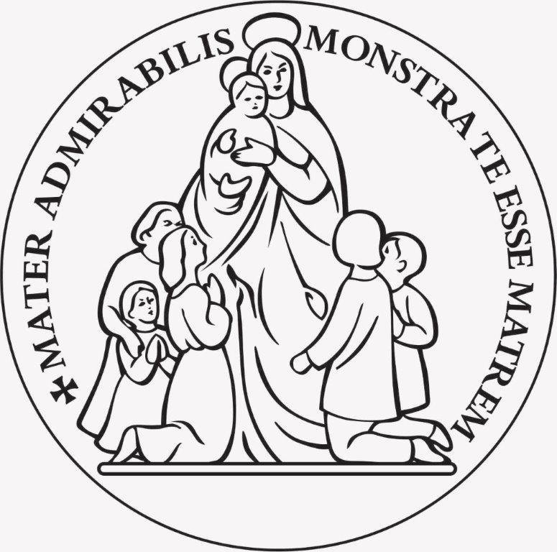
Introduction

Slide 4
Introduction

Slide 5
Introduction

Slide 6
Introduction

Slide 7
Background to the document

Slide 8
Why a directory?
A directory draws on a range of Church documents to establish principles and good practice and applies them to a particular aspect of Church life.
In this case, the Directory offers guidance for the celebration of prayer and liturgy in schools in England and Wales.
It is a companion volume to the RE directory ‘To know You more clearly’ and the forthcoming Catholic life and mission directory ‘To follow You more nearly’.
It is approved by the full Conference of Bishops in Spring 2023 and states a common approach to prayer and liturgy across all Catholic schools in a diocese.
NB. Religious order schools may have additional documents that align with the charism of their order.

Slide 9
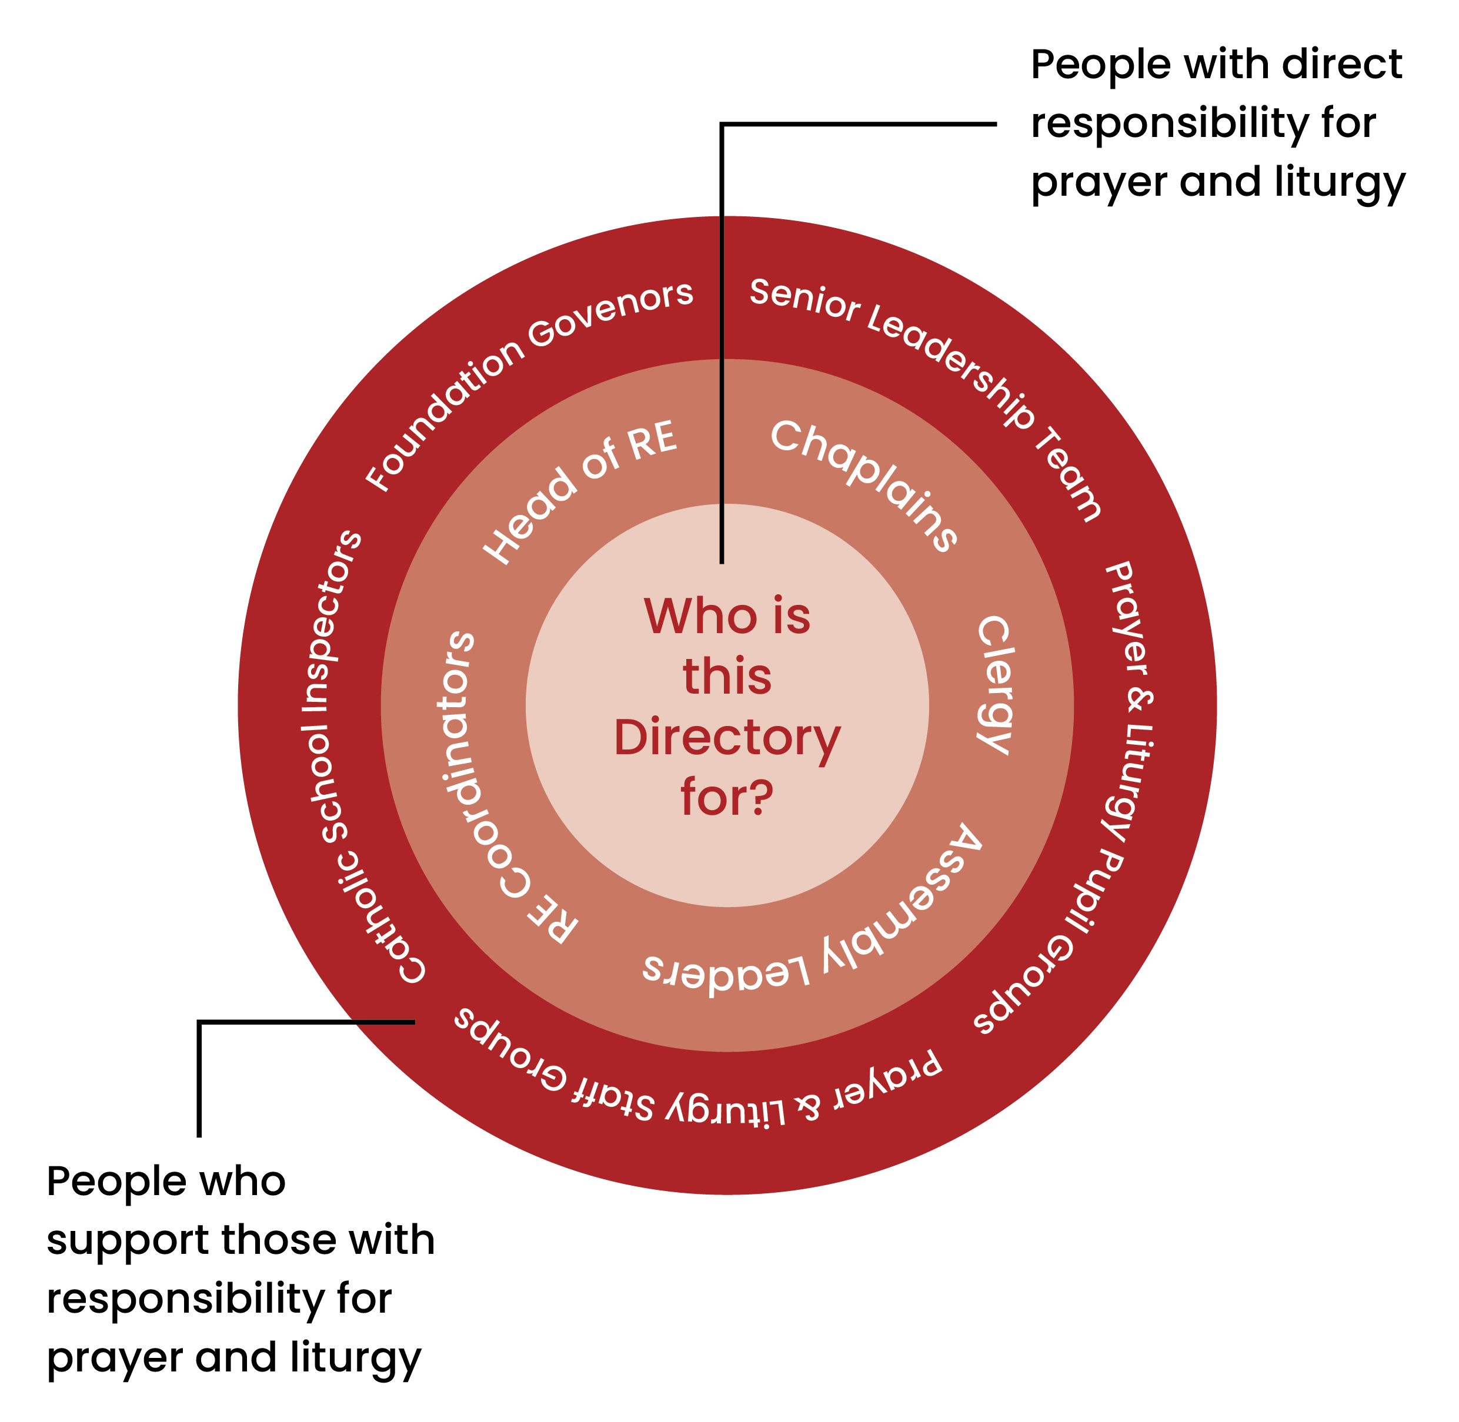
Who is the directory for?

Slide 10
Clarification of terms

Slide 11
Prayer

Slide 12
Prayer
Prayer has been traditionally described as ‘lifting up of the hearts and minds to God’, which means it involves our whole person – our head as well as our heart.
God calls humanity into prayer. It is a universal experience of God’s revelation, an ‘initiative of love’ (CCC 2567)

Slide 13
Prayer
Communal prayer forms an essential dimension of life in a Catholic school. Staff and pupils are invited to recognise God’s action in their lives and the life of the school, and in response to express together their needs and those of the whole human family, and to offer thanks for all that is good.
Examples include, classroom prayer at start or end of day and prayer at the start of staff meetings.

Slide 14
Celebrations of the Word

Slide 15
Celebrations of the Word
As the time allotted to prayer lengthens and the number of people involved grows, there is a corresponding need for more formal structures.
The term ‘celebrations of the word’ is used in this Directory for celebrations which are created for the school community and not directly taken from the liturgical books of the Church.

Slide 16
Celebrations of the Word
These celebrations will take many forms, but the common element is the proclamation of scripture. For example, assemblies, carol services, special occasions
They may draw upon elements of the liturgy, such as its texts, symbols, and gestures, which help to reinforce their Catholic nature, but the various elements may be used with greater creative freedom than in the liturgy itself.

Slide 17
Celebrations of the Word
Please note: the term ‘liturgical prayer’ that was in the consultation document is not in the PLD and was not approved by the Bishops’ Conference.

Slide 18
Liturgy

Slide 19
Liturgy
The most familiar forms of the liturgy celebrated in school are the Mass and the Sacrament of Reconciliation.
The liturgical books, such as the Roman Missal and the Lectionary, set out the structure to be followed, the words to be spoken, the gestures to be performed, and the symbols to be used when celebrating a liturgy.
The possibility for some creativity and adaptation remains. But they have to be exercised within the parameters authorised by the liturgical books.

Slide 20
Together
Prayer, celebrations of the word, and liturgy form a continuum with silent meditation at one end and a celebration of Mass on a Solemnity of the Church (e.g., Ascension of the Lord) at the other.

Slide 21
Together
The liturgy is the summit toward which the activity of the church is directed; at the same time, it is the font from which all her power flows. (SCn10)

Slide 23
Structure and contents

Slide 24
Part One —the foundations and themes of the document
Catholic schools in England and Wales, and key principles of prayer and liturgy.
Contexts — the Church, governance, social and educational contexts in which the school operates.
Understanding prayer and liturgy — a thorough examination of the key principles undergirding the Catholic Church’s understanding of prayer and liturgy.

Slide 25
Part Two —the people who make up the school community and how we facilitate their engagement in prayer and liturgy.
The school community — the overarching roles and responsibilities for prayer and liturgy within the school.
The school community at prayer and liturgy — the Catholic community and welcoming the presence of other Christians, those from other faith traditions and of no particular faith.

Slide 26
Part Three — develops the principles of prayer and liturgy in the context of the school community.
Looking at prayer and liturgy — the building blocks of prayer and liturgy, including symbol, scripture, music, silence, space.
Models of prayer and liturgy — the common structures of prayer and liturgy in the Catholic tradition, including the Mass, Reconciliation, classroom prayer.
Application — Developing a School Prayer and Liturgy Policy; making appropriate adaptations; preparing, monitoring and evaluating; providing resources.

Slide 27
Inclusion
Chapter 5 was substantially revised after the second consultation to address concerns about inclusion.
Triple aim of the directory in this regard:
To embrace the rich diversity present in our schools;
To reflect the understanding and teaching of the Catholic Church;
To respect the different religious sensitivities and needs within the school community.
Developing a shared understanding of inclusion will be one of the central challenges as the directory is implemented.

Slide 28
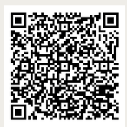
Orders
Order your copy of the Prayer and Liturgy Directory directly from YPD books
https://www.ypdbooks.com/coming-soon/2210-to-love-you-more-dearly-prayer-and-liturgy-directory.html
There will be a single print run of the PLD, when it’s gone it’s gone!

