Slide 1
Spring 2023
Autumn 2023
Early 2024
£16.99 per book
£4.50 per ebook

Slide 2
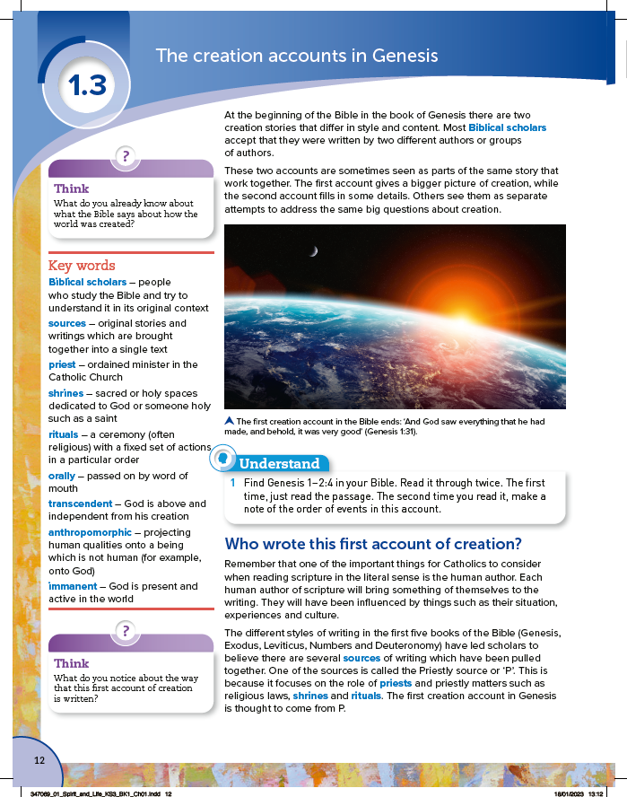
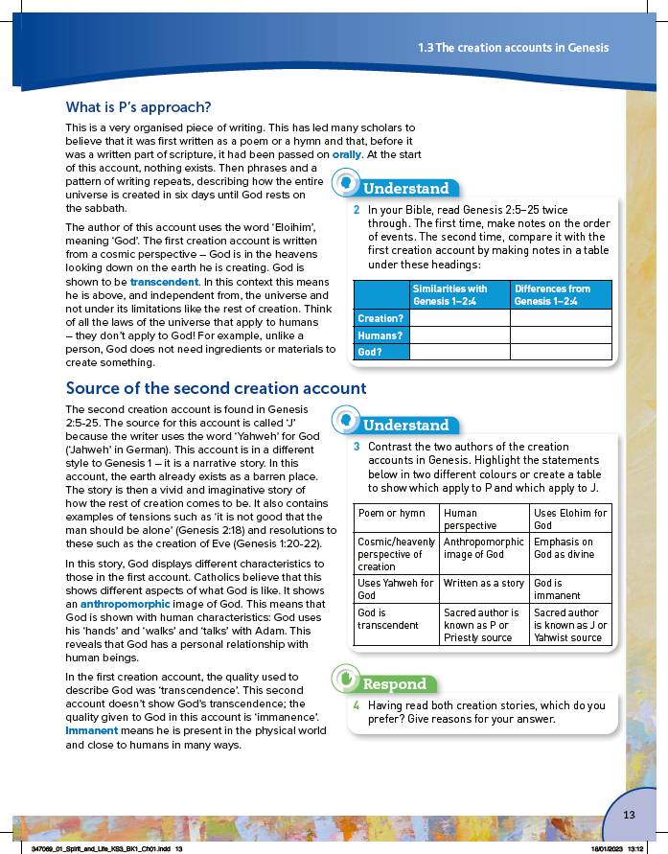

Slide 3
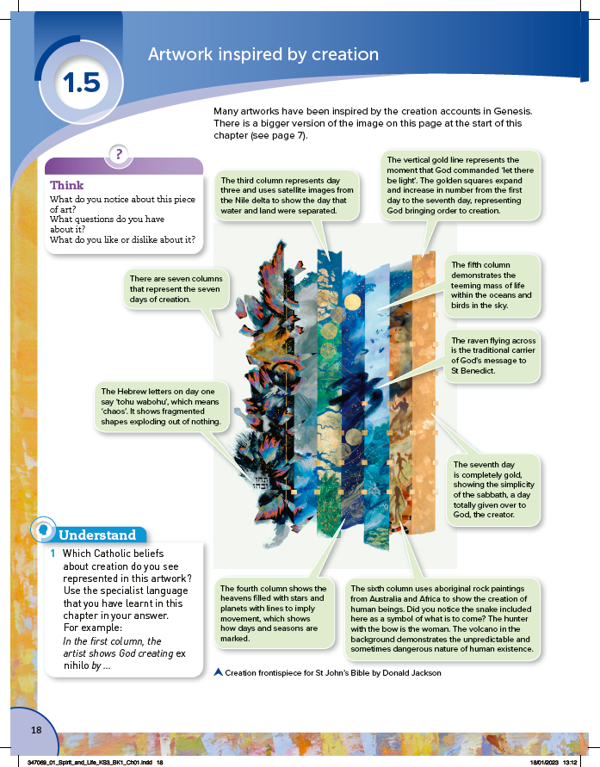

Slide 4
Digital teaching and learning resources
Spring 2023
Autumn 2023
Spring 2024
Quizzes · presentations · worksheets · teacher notes
£100 +VAT each for an annual subscription

Slide 5
To see further sample material and pre-order, please email RE.Team@hodder.co.uk with your school name and postcode.
Follow us on Twitter: @hodderRE

