Slide 1
Source to Summit
A new resource for Key Stage 3 Catholic RE

Slide 2
We want to tell the story of the Catholic faith - from Genesis to the lived Church of today.

Slide 3
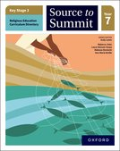
Source to Summit…
is authored by a team of practising teachers,
lead by Series Editor Andy Lewis
is a blended offering of student books and
accompanying digital resources
is designed to give teachers the practical
resources they need to feel confident to deliver
the new curriculum
is designed to engage students and help them
understand and remember what they need to learn
comprehensively covers the new RED – we are
seeking an Imprimatur and CES endorsement

Slide 4
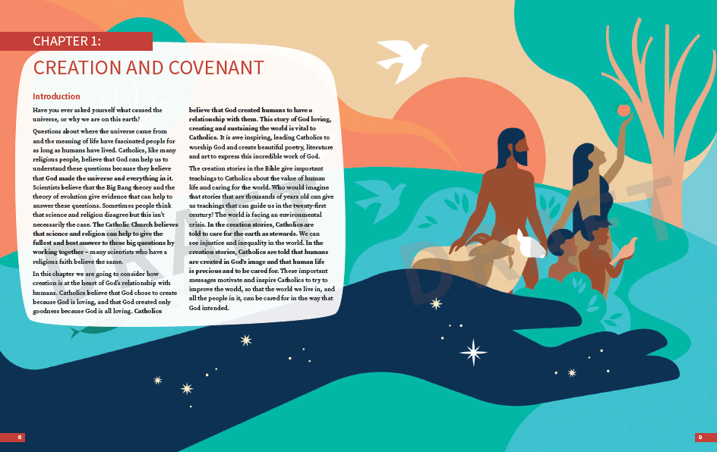
Inviting chapter openers feature specially-commissioned artworks and a chapter overview to set out our narrative approach.

Slide 5
1 spread per lesson, with topics carefully sequenced
Clear learning objective and introduction
Useful vocabulary is defined
Understand, Discern and Respond activities test the three ways of knowing

Slide 6
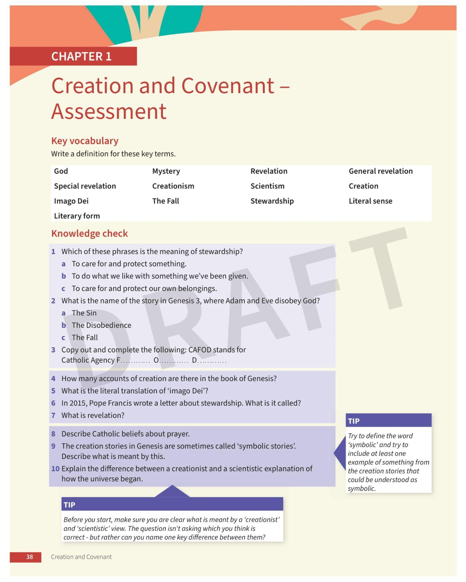
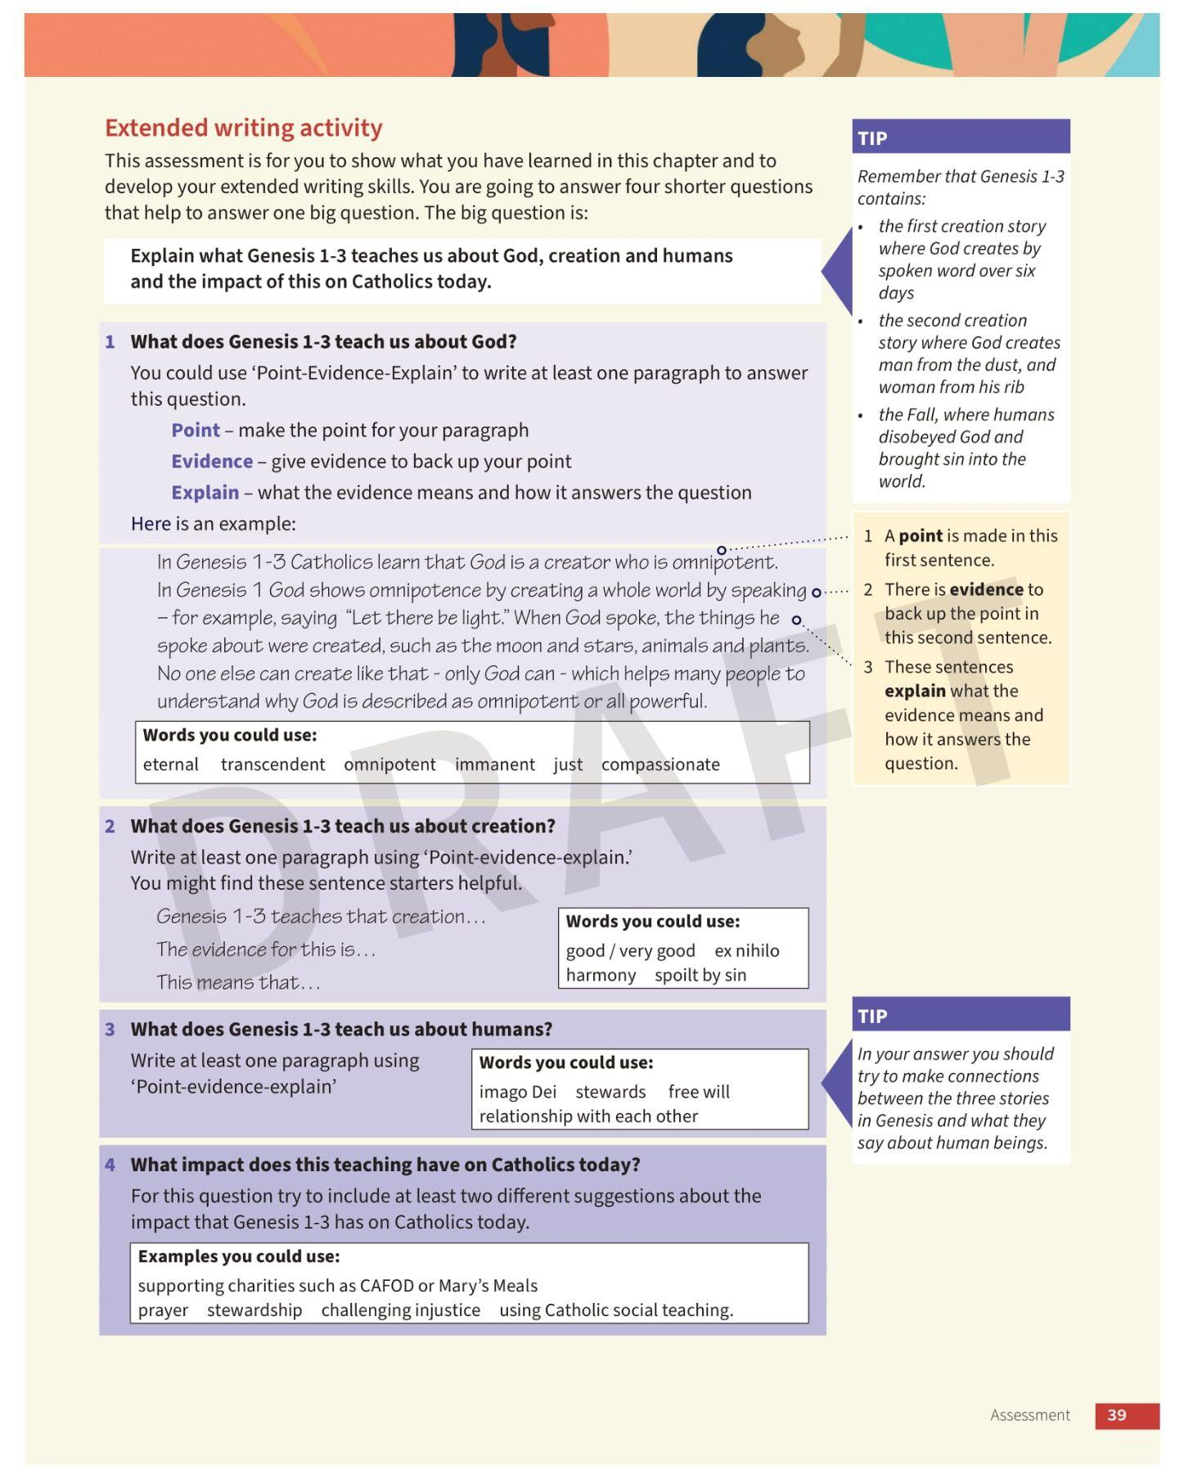
Key vocabulary
Knowledge check
Extended writing activity
Mark schemes and answer guidance provided on Kerboodle

Slide 7
Source to Summit Kerboodle
Digital resources on Kerboodle include:
Kerboodle Book
Scheme of work
Knowledge organisers
Retrieval quizzes
Image galleries
Activity worksheets for every lesson
Engaging with text commentary and worksheets
Automarked vocabulary quizzes
Key vocabulary matching activity worksheets
Automarked knowledge quiz
Answers to Student Book activities
Assessment answer guidance and mark scheme
Kerboodle support
Schools can call on our expert Educational Consultants to demo and support teachers to get the best out of Kerboodle.
Free early access

Slide 8
Editable scheme of work
Maps RED content and expected outcomes to our resources
Includes recommendations for further reading and resources

Slide 9
Knowledge organiser and retrieval quiz

Slide 10
Activity worksheets
Foundation activity worksheets with sentence starters and hints available for every lesson
Aim to support students in answering the Understand and Discern activities
Notes:
A reminder that we have activity worksheets with sentence starters and hints for every lesson in the book. It’s been commented frequently that the content of the RED is very challenging, so these worksheets aim to support students in engaging with and answering questions on this content.

Slide 11
Assessment guidance and mark scheme
Detailed marking guidance for the end of chapter assessments.
Includes sample answers matched to three different assessment bands: developing, secure and extending.
Notes:
A reminder that we will include comprehensive assessment support on Kerboodle to accompany the end-of chapter assessments in the Student Book. This will include a detailed Assessment and marking guidance document for teachers to support them in marking student answers. Answers guidance for the end-of-chapter extended writing activities is split into three bands: developing, secure and extending. Sample answers are provided to demonstrate to teachers how a student working at each level might respond to a question.
Minh Ha will now talk to you about our competition.

Slide 12
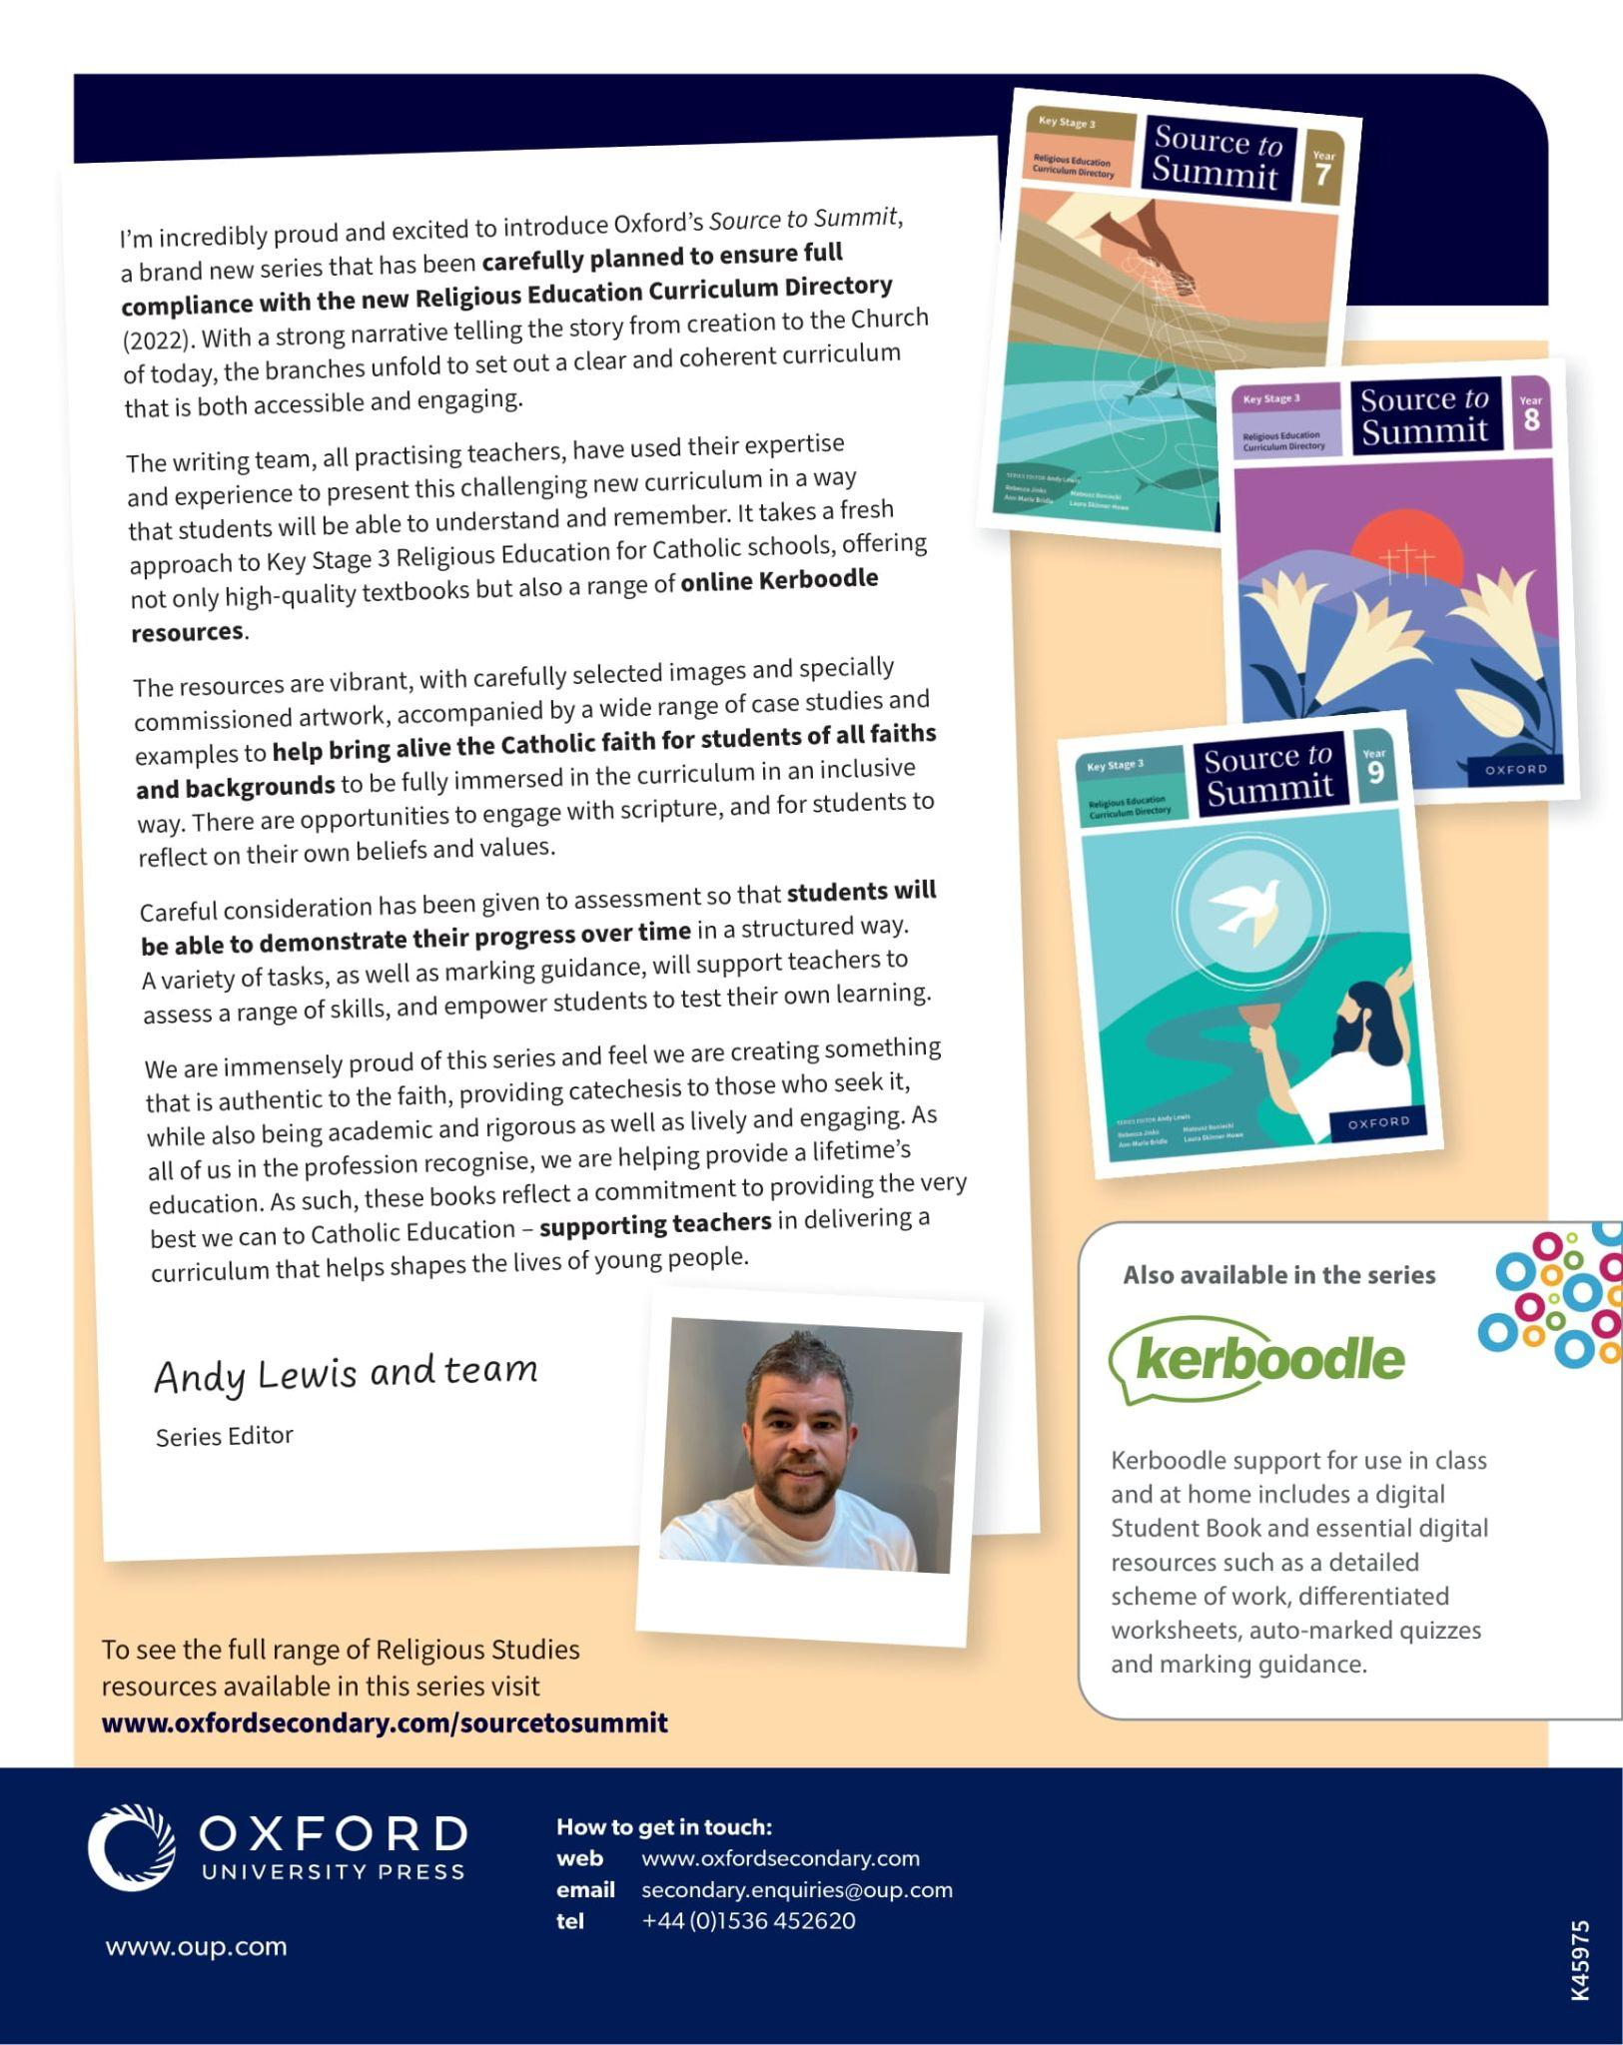
We want students to understand and remember the RED.
We want to bring alive the faith for students of all faiths and backgrounds.
We want to demonstrate inclusivity and diversity.
We want students to show progress over time through their assessments.
We want to be authentic, catechetical for those who seek it, academic and rigorous.

Slide 13
Year 7:
March 2023
Year 8:
January 2024
Year 9:
September 2024
Student Books priced at £16
Kerboodle £200 for an annual subscription
If you have any further questions, please do contact me at minhha.duong@oup.com

Slide 14
Thank you
Notes:
Last 10 mins

