Slide 1
Catholic Life and Mission
Section 50 Part 1
CSED

Slide 2
Genesis 1
God Created the Realm
God Filled the Realm and it Flourished
Day 1 Light and Dark
Day 2 Sky and Water
Day 3 Land and Plants
Day 4 Sun, Moon, Stars
Day 5 Birds and Fish
Day 6 Land Animals and Humans
Day 7 – God Rested

Slide 3
Our Catholic Life and Mission is all about the school we create and how we fill and use that space to develop children to care for others.
We are called to serve society

Slide 4
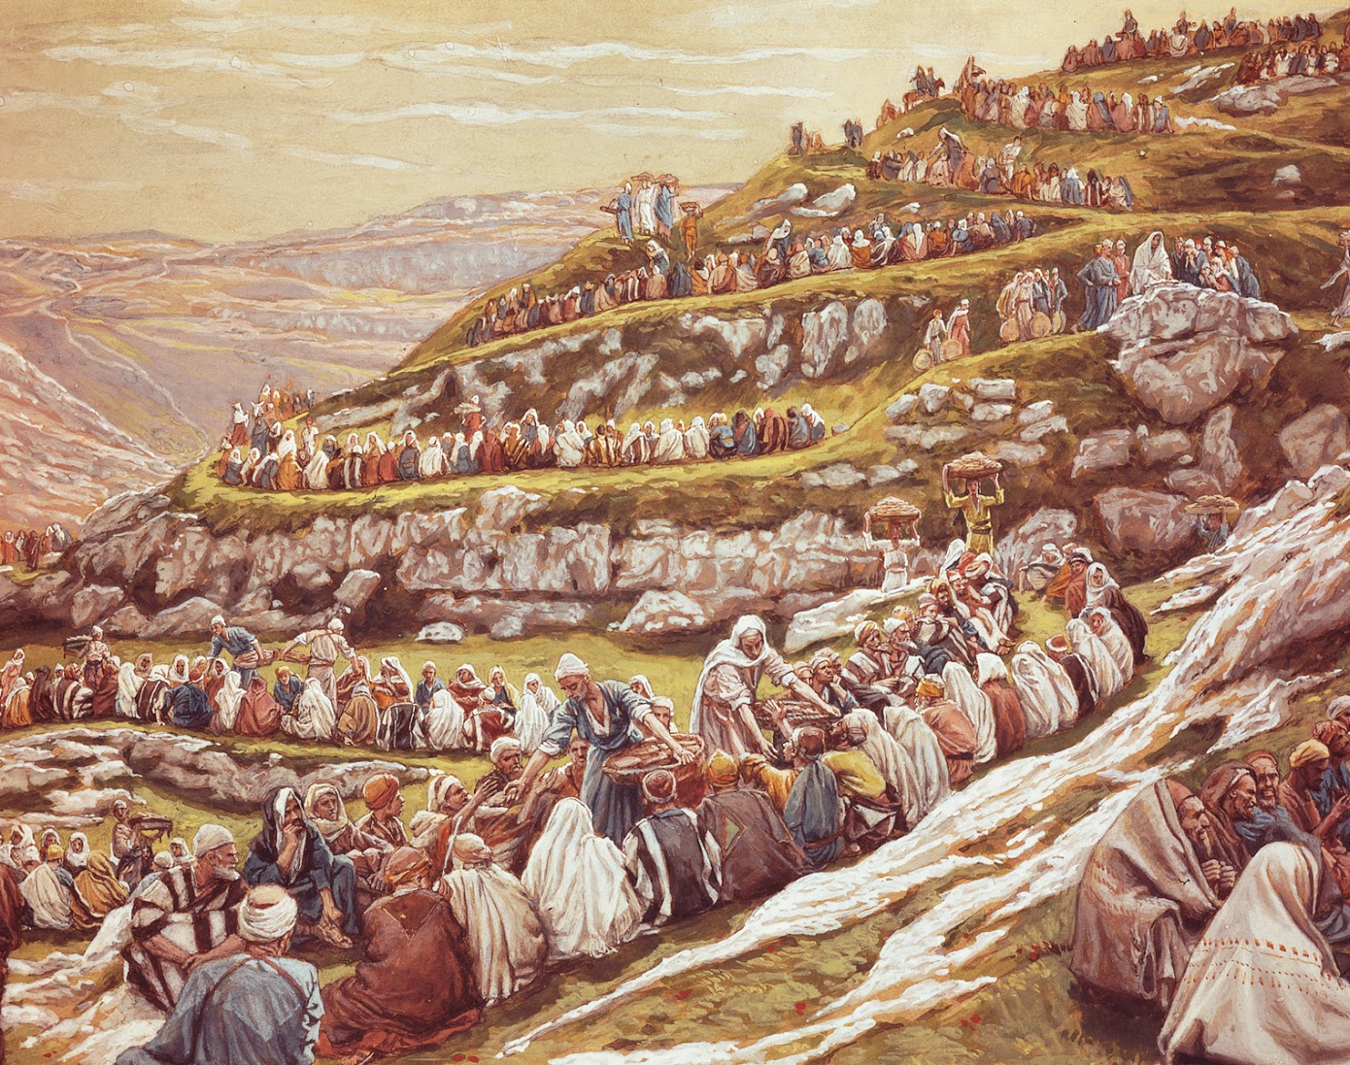
Reading - Matthew 14 : 13-21

Slide 5
Our Catholic Schools - Our Catholic Life and Mission
We are the custodians of our schools for the Diocese and the Catholic Faith
We build our ‘realm’
We fill it with children, staff, parents, governors
We keep providing experiences
We watch children flourish
We help them to support society
We see our work multiply
We rest

Slide 6
CSED
Catholic Life and Mission |  |  | Religious education |  |  | Collective worship
CLM1 The extent to which pupils contribute to and benefit from the Catholic life and mission of the school |  |  | RE1 How well pupils achieve and enjoy their learning in religious education |  |  | CW1 How well pupils respond to and participate in the schools’ collective worship.
CLM2 The quality of provision for the Catholic life and mission of the school |  |  | RE2 The quality of teaching, learning and assessment in religious education |  |  | CW2 The quality of collective worship provided by the school
CLM3 How well leaders and governors promote, monitor, and evaluate the provision for the Catholic life and mission of the school |  |  | RE3 How well leaders and governors promote, monitor, and evaluate the provision for religious education |  |  | CW3 How well leaders and governors monitor and evaluate the provision for collective worship

Slide 7
1. Pupils contribute to and benefit from the Catholic Life and Mission - Criteria
• How well pupils understand, value, and contribute to the school’s Catholic life and mission
• How well pupils understand that they are valued and loved as unique persons, made in the image and likeness of God
• How well pupils flourish as they seek opportunities to grow in virtue
• How well pupils respond to Catholic Social Teaching
• The extent to which pupils show respect for themselves and others
• How well pupils respond to the school’s chaplaincy provision.

Slide 8
Pupils contribute to and benefit from the Catholic Life and Mission - Evidence
conversations and interviews with pupils
• conversations and interviews with staff and school leaders
• conversations and interviews with those involved with the provision of chaplaincy in school
• records of pupil involvement in charitable activities and campaigns, for example Caritas, Cafod, Missio, ACN, SVP, Mini Vinnies
• records of pupil involvement in advocacy work and campaigning work and transformational action for the poor, the marginalised and the unjustly treated, for example writing to MPs, sending Christmas cards to prisoners, work for climate concerns

Slide 9
Pupils contribute to and benefit from the Catholic Life and Mission - Evidence (cont)
• records of pupil involvement in activities that contribute to the life and mission of the school, such as choirs, prayer groups, Bible studies, school chaplaincy teams, Growing in Faith Together (GIFT) programme, social justice groups, Eco groups and young leadership programmes
• records of pupil involvement in those awards that further the Catholic life and mission of the school, such as the and the Faith in Action, Live Simply, and John Paul II and Oscar Romero awards

Slide 10
Pupils contribute to and benefit from the Catholic Life and Mission - Evidence (cont)
record of pupil involvement with acts of solidarity with the poorest and most vulnerable in the world, such as water saving, Fairtrade or recycling schemes
• international links with other schools, particularly in developing countries
observations of pupils’ attitudes and behaviour in lessons and around school
• the views of pupils and parents/carers on the impact of the school’s Catholic life and mission on the wellbeing and character formation of pupils
information on the school website and other social media
• notice boards around school.

Slide 11
2. Provision Criteria
• How well the school’s Catholic life and mission embody the educational mission of the Church or of the school’s particular charism
• The extent to which staff embrace the Catholic life and mission of the school
• The strength of the school community in supporting every one of its members
• The extent to which the school provides for those from other faith and belief traditions
• The extent to which staff bear witness to the Catholic life and mission of the school

Slide 12
2. Provision Criteria (cont)
The quality of the pastoral care provided for pupils
• How well the school environment witnesses to its identity, mission, and charism
• The centrality of chaplaincy to the life and mission of the school and the quality of the provision for spiritual and moral development of pupils and staff
• How well planned the curriculum is for Relationships Education; Relationships and Sex Education; and Health Education, hereafter referred to as R(S)HE, and the extent to which it is rooted in the teaching of the Church.

Slide 13
Provision - Evidence
• The quality of the pastoral care provided for pupils
• How well the school environment witnesses to its identity, mission, and charism
• The centrality of chaplaincy to the life and mission of the school and the quality of the provision for spiritual and moral development of pupils and staff
• How well planned the curriculum is for Relationships Education; Relationships and Sex Education; and Health Education, hereafter referred to as R(S)HE, and the extent to which it is rooted in the teaching of the Church.

Slide 14
Possible Evidence
the school’s mission statement
• conversations and interviews with staff and school leaders
• the physical environment of the school, the presence and visibility of artefacts and other physical signs of the school’s Catholic character
• conversations and interviews with those involved with the provision of chaplaincy in school
• school policies relating to the pastoral care of pupils, such as the behavior management policy, the bullying policy and the school’s curricula for R(S)HE
• the record of school staff development opportunities both historical and planned

Slide 15
Possible Evidence
• records of staff involvement in activities that contribute to the life and mission of the school, such as choirs, prayer groups, Bible studies, school chaplaincy, the Growing in Faith Together 31 (GIFT) programme, Rainbows Bereavement GB, social justice groups, Eco groups and young leadership groups
• records and plans the school has for the spiritual and moral development of the whole community, such as retreats, pilgrimages, and days of recollection for pupils and staff
• evidence of school supporting local projects to support the marginalised and vulnerable, e.g. supporting refugee families locally, free school meal campaigns

Slide 16
Possible Evidence
evidence of school commitment to the environment and care for our common home, e.g. wildlife gardens or Laudato Si’ prayer gardens
• records or plans relating to working together on joint global learning projects or charitable activities and campaigns with other schools within a multi academy trust or other partnership
• pupil and staff questionnaires recording the quality and impact of the spiritual and moral development opportunities provided by the school
• meeting agenda and minutes.

Slide 17
Leaders and Governors promote, monitor and evaluate provision for CLM - Criteria
• The commitment of leaders and governors to the Catholic life and mission of the school
• The extent of their engagement with the diocese
• The extent to which the school puts itself at the service of the local Church
• The extent to which school leaders and governors acknowledge parents as the first educators of their children and support them in that vocation
• The commitment of leaders and governors to Catholic Social Teaching
• The extent to which leaders and governors demonstrate respect for the rights and dignity of employees
• The extent to which the whole school curriculum reflects a Catholic worldview

Slide 18
Leaders and Governors promote, monitor and evaluate provision for CLM - Criteria
• The commitment of governors to the Catholic life and mission of the school and their effectiveness as guardians of the Catholic life and mission of the school
• The quality and effectiveness of the self-evaluation processes of the school
• The extent to which pupil voice is included in self-evaluation processes
• The frequency and quality of professional development opportunities devoted to the Catholic life and mission of the school
• The effectiveness of induction of new staff into the Catholic life and mission of the school

Slide 19
Leaders and Governors promote, monitor and evaluate provision for CLM - Evidence
conversations and interviews with staff and school leaders
• records of leader and governor participation in local or national formation programmes that focus on their spiritual and professional formation as guardians of the Catholic life and mission of the school
• conversations and interviews with parents/carers, local clergy and diocesan officers
• school self-evaluation documents and assessments of the impact of planned improvements to the provision for the Catholic life and mission of the school
• records of the ways in which leaders have engaged with all stakeholders in their evaluation of the Catholic life and mission of the school

Slide 20
Leaders and Governors promote, monitor and evaluate provision for CLM – Evidence (cont)
records of self-evaluation processes that show how the views of pupils are taken into account (e.g. records of pupil questionnaires
• evidence of partnership working with the diocese to support the wider family of Catholic schools in the diocese
• evidence of the commitment of leaders to those enrichment activities that further the Catholic life and mission of the school, such as promoting and resourcing schemes that reward pupils for putting faith into action (for example, the GIFT programme, Live Simply and the Faith in Action, John Paul II and Oscar Romero awards)

Slide 21
Leaders and Governors promote, monitor and evaluate provision for CLM – Evidence (cont)
• the school timetable and curriculum and records of cross-curricular working
• evidence that the school has made provision for vulnerable pupils, including those who have not been able to flourish in other settings
• the record of school professional development opportunities both historical and planned
• meeting agenda and minutes.

Slide 22
…..and other examples………
This is not an exhaustive list and inspectors may well need to triangulate these sources of evidence against other relevant ones.
Equally, there will be sources of evidence a school is able to provide that may not have been considered in this list.
Inspectors will consider all relevant evidence presented before and during the inspection.

Slide 23
Diocesan Updates
Prayer and Liturgy Directory Due digitally at the beginning of September 2023
Hard copy publication – not yet known.
Buildings Update CRAMP allocation is out to schools.
Our Lady’s / St Mary’s, Wrexham, Santes Helen / SRG
Flintshire consultation – highly confidential
Aim to start work on a Catholic Life and Mission Directory from September 2023

Slide 24
Diocesan Updates (cont)
Secondary Resources for RED OUP – Imprimatur/Endorsed/published
Hodder - Imprimatur/Endorsed/published
Vine and Branches – No/ no/Pub partly
Cafod and Magister – to be reviewed by Philip Robinson
RED CPD
Primary Resources for RED Ten:Ten / Hodder/OUP/Vine and Branches/ Redemptorist all interested in possibly producing resources
‘Come and See’ website closes Sept 2023

Slide 25
Diocesan Updates (cont)
Governors Need DSB check and Safeguarding training. Being picked up by Estyn
Protocols Launch 6th July 2023 4.00pm – 5.30pm
Ten Ten Online Training Access to all Ten:Ten online training ends at the end of February 2024. This has been purchased for all schools by a grant and CES at the cost of £500 per school.
Looking Ahead Book for Pupils

Slide 26
Diocesan Updates (cont)
RSE Polices for Wales Uploaded July 2023 for Wales Catholic Schools
CES Website and Wrexham Diocese Website
Curriculum for Wales Catholic Supporting Guidance
Good Practice in developing a School Policy for RSE
Model RSE Policy
Who is Responsible for Teaching RSE to Children and Young People
Governors’ Audit for Monitoring RSE
Catholic RSE Quality Standard

Slide 27
Diocesan Updates (cont)
Estyn Consultation 5 aspects moving to 3 – T&L/Care, support, wellbeing /lead&improve
Every school inspected within 2016-24 cycle – 1 inspection/1 other
Reviewing wider stakeholders input
Every six year – 2 visits
We track trends for risk assessment/Welsh

