Slide 1
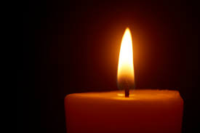
Let us come together in prayer

Slide 2
As we take time away from our busy schools let us bring ourselves to God, to reflect on who we are, and who God wants us to be.

Slide 3
The Lord is kind and full of compassion,
slow to anger, abounding in love.
How good is the Lord to all,
compassionate to all his creatures.
The Lord is faithful in all his words
and loving in all his deeds.
The Lord supports all who fall
and raises all who are bowed down.
The Lord is just in all his ways
and loving in all his deeds.
He is close to all who call him,
who call on him from their hearts.
Psalm 144

Slide 4
Let us pause and reflect on how the Lord’s compassion and love touches our lives and in turn, how we share these gifts with others.

Slide 5
We pray for our school communities that, as the challenges of Holy Week turns into the joy of the Resurrection, we may have the strength to lead our schools in the light of the risen Lord.
Lord in your mercy . . . . . . . . . . .
Hear our prayer.
We pray for the children and young people of our schools, may they continue to grow in the love of God as they journey through Lent.
Lord in your mercy . . . . . . . . . . .
Hear our prayer.
On this World Water Day we pray for all who thirst for water, justice or peace. May we work together so all people may flourish.
Lord in your mercy . . . . . . . . . . .
Hear our prayer.
Let us now turn to Mary and ask her to pray with us Hail Mary……………

Slide 6
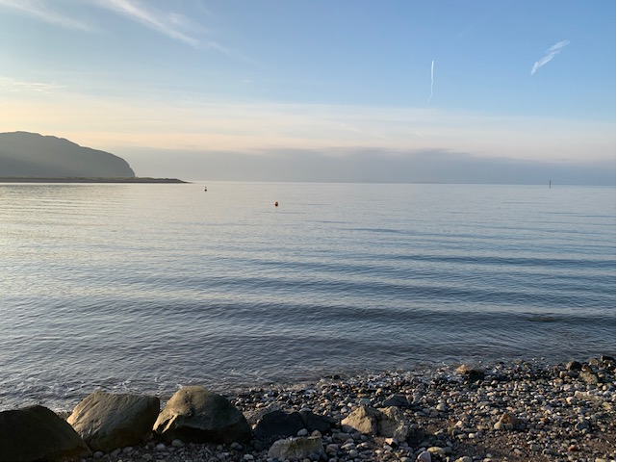
We pray that our family of diocesan schools may continue to work together to fulfil the vision of making Christ known and loved in our schools and communities.
We ask this through Christ our Lord, Amen.

