Slide 1
CHILD PROTECTION
SAFEGUARDING CHILDREN
Notes:
Introduce yourself and, in case some don’t know, mention your role in school where safeguarding and child protection is concerned (if you are the DTCP say that you will talk about this in more detail during the presentation)
This is a basic awareness session for ALL staff in school on safeguarding and child protection
The session will last 2 hours
Make clear that whoever you are and whatever you do in school, you have a responsibility to be clear about arrangements for child protection
Before outlining at aims and objectives (next slide) acknowledge that child abuse is an emotive subject and that people bring a range of experiences, knowledge, values and beliefs to training around it.
The session will enable participants to explore what they know, what they believe and how they feel about child protection, and understand how this might impact upon their practice
If anyone struggles with anything at all that emerges for them during or after the session then they can access support via DCPT or Cardiff Council Counselling Service…

Slide 2
OBJECTIVES
Understand the Safeguarding Agenda for Schools and where child protection fits into it
Be clear about your governor roles and responsibilities within Safeguarding
Child protection allegations made against professionals and procedures to be followed
Notes:
Go through each of the bullet points explaining that these are minimum requirements
Explain that the school has a child protection policy which everyone should already be aware of and have read
If anyone hasn’t then they can get a copy from DCPT
Will there be any breaks? Are you going to use any case studies or exercises? What scope will there be for discussion?
Any questions before we start?

Slide 3
What is safeguarding and promoting a child’s welfare?
Safeguarding is about keeping children safe from harm and abuse. This means keeping children safe from accidents, crime and bullying and actively promoting their wellbeing in a healthy, safe and supportive environment
…so as to enable them to have optimum life chances in adulthood

Slide 4
Child Protection
Anti Bullying Policies
Intimate Personal Care
Attendance
Safeguarding
Curriculum
E-Safety
Safe Use of Internet
Young Carers
Behaviour
Management
e.g Physical Intervention
Building Design
Health and Safety
Staff Conduct/Section V
WSP
Safe
Recruitment and Selection

Slide 5
What is the relation between child protection and safeguarding?
Safeguarding means proactively seeking to involve the whole community in keeping children safe and promoting their welfare.
Child protection is the process of protecting individual children identified as either suffering, or at risk of suffering significant harm as a result of abuse or neglect.

Slide 6
Categories of abuse
The Wales Safeguarding Procedures identify five categories of abuse:
Physical
Sexual
Emotional/Psychological
Neglect
Financial Abuse

Slide 7
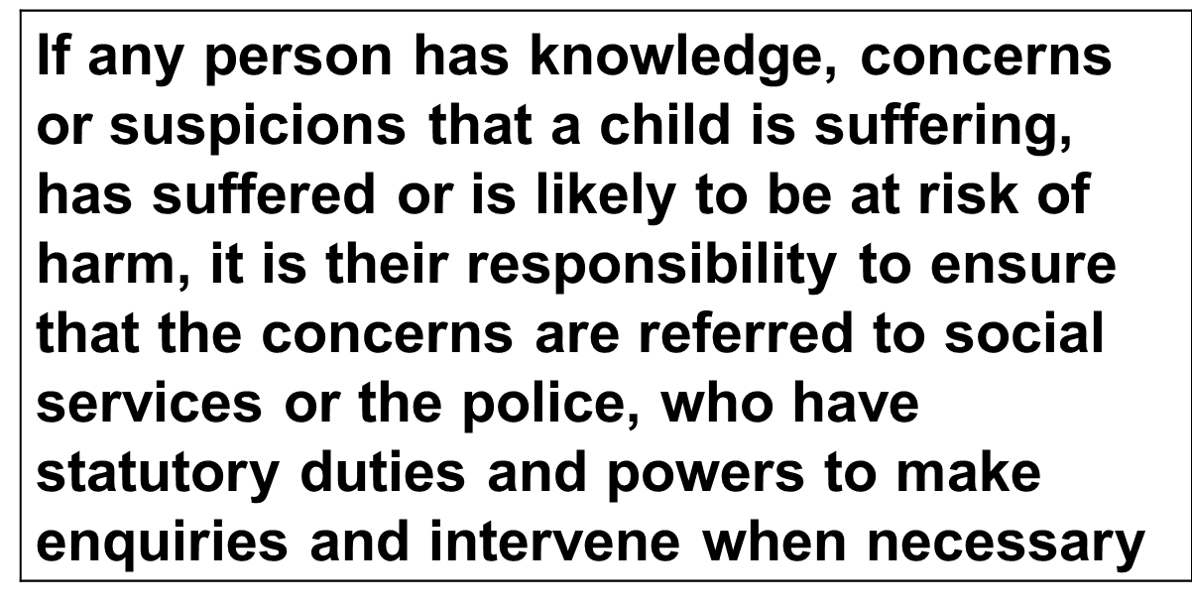
Duty To Refer
Social Services and Well-being (Wales) Act 2014

Slide 8
Consent and confidentiality
Referral as a ‘child in need of care and support’ parental consent must be sought. There is a duty on the local authority to assess a child who appears to need of care and support in addition to, or instead of, the care and support provided by their family.
Referral as ‘child protection’ – parental consent is not required. However, after consultation with social services when the verbal referral is made staff may be advised to seek parental consent.
Personal information about children and families held by professionals and agencies is subject to a legal duty of confidence and should not normally be disclosed without the consent of the subject. However the law permits the disclosure of this information if it is necessary to safeguard the welfare of the child.
The needs of the child must come first.
Notes:
A child In Need usually has a combination of needs and stresses which will severely affect their outcomes in both the long and short term unless there is a concerted effort to create improvements, but they do not require child protection measures at this time (consent required)
A child in need of protection is at imminent risk of significant harm (consent not required)
Information should only be shared on a ‘need to know’ not ‘would like’ to know basis.
If you are asked information about a child and/or its family and are unsure about divulging that information then seek advice from DCPT beforehand

Slide 9
Physical Abuse
Hitting, slapping, over or misuse of medication, undue restraint, or inappropriate sanctions

Slide 10
Sexual Abuse
Forcing or enticing a child or young person to take part in sexual activities, whether or not the child is aware of what is happening, including: physical contact, including penetrative or non-penetrative acts; non-contact activities, such as involving children in looking at, or in the production of, pornographic material or watching sexual activities or encouraging children to behave in sexually inappropriate ways

Slide 11
Neglect
Failure to meet basic physical, emotional or psychological needs which is likely to result in impairment of health or development

Slide 12
Emotional/Psychological Abuse
Threats of harm or abandonment, coercive control, humiliation, verbal or racial abuse, isolation or withdrawal from services or supportive networks, witnessing abuse of others

Slide 13
Financial Abuse Financial Abuse This category will be less prevalent for a child but indicators could be: not meeting their needs for care and support which are provided through direct payments; or complaints that personal property is missing

Slide 14
Allegations Against Staff Member in a School Setting
Report to Headteacher (or COG if allegation is in respect of Head)
The Head or COG makes initial enquires (but not investigate) i.e. Who, What, Where, When.
Contact MASH where there is a clear allegation of abuse – physical, emotional or sexual - advise of the incident and subsequently complete a referral form.
Contact your named HR officer (at this point a decision around suspension / Risk Management will need to be considered)
If the allegation is against agency staff - contact the agency’s Safeguarding Officer
Discuss the incident with parents, sharing enough information as is relevant
MASH will liaise with the Designated Officer for Safeguarding (DOS) and hold a strategy discussion if it meets criteria, consideration given to S.47 investigation.
If it doesn’t reach criteria, it will refer back for internal investigation / disciplinary where required.
If it does meet criteria then a professional strategy meeting will be held and either the Head or COG invited.
CONTACT MASH OR HR IF YOU ARE UNSURE IF IT REACHES CRITERIA

Slide 15
Safer Schools – allegations against staff members
Loyalty vs Concern
Reporting concerns – refer don’t investigate
Think the Unthinkable

Slide 16
Governor Responsibilities
The school has an effective child protection policy and procedures in place that is in accordance with local authority guidance and locally agreed interagency procedures
The school’s child protection policy and procedures are:
Available to parents and carers
Provided in a format appropriate to the understanding of children, and in particular for children with additional needs
Ensure the school operates safe recruitment procedures that take account of the need to safeguard children and young people, including arrangements to ensure that all appropriate checks are carried out for new staff and volunteers who will work with children, including relevant DBS checks
Ensure that the headteacher and all other permanent staff and volunteers who work with children undertake appropriate training to equip them with the knowledge and skills that are necessary to carry out their responsibilities for child protection effectively: and is kept up-to date by refresher training

Slide 17
Governor Responsibilities
Give clear guidance to temporary staff and volunteers providing cover during absences and who will be working with children and young people on the schools arrangements for child protection and their responsibilities
Ensure that the governing body addresses any identified weaknesses in regard to child protection arrangements that are brought to its attention
The governing body to ensure that the designated senior person (DSP), designated governor for child protection and the chair of governors undertake and maintain relevant safeguarding training as agreed by the Regional Safeguarding Board.

Slide 18
The protection of children is a multi agency responsibility.
You might hold a small
part of that jigsaw
Thank you

Slide 19
Useful Contacts
Lynda Gallagher – Designated Safeguarding Officer (DOS) 02922 330889
Kate Willington - Education Safeguarding Officer
Nikki Loukisas – Education Safeguarding Officer 02922 330876
Jo Bowman – Education Safeguarding Officer 02922 330876
Amy Powell – Education Safeguarding Officer 02922 330876
Alexis Morley - Education Safeguarding Officer
MASH Children's Access Point Team Children's Services 02920 536490
Emergency Duty Team 02920 788570
RSB Website: https://www.cardiffandvalersb.co.uk/

