Slide 1
Catholic Schools Inspectorate
Part 2
The Inspection Process

Slide 2
Catholic Schools Inspectorate Website

Slide 3
Catholic Schools Inspectorate Website
https://catholicschoolsinspectorate.org.uk

Slide 4
Preparing for the new CSI Framework
Working Parties
Framework Inspection Criteria & Judgements (Fr Bernard Sixtus)
The Inspection Process (Paul White)
Training for Schools
Recruitment and Accreditation of Inspectors
Working towards an All Wales Team of Inspectors
Interview by Sponsoring Diocese
National Training and Assessment (2 days)
Enhanced DBS Disclosure DBS and registration with online Update Service
Accreditation by the CSI

Slide 5
All Wales Inspectorate Team
Original plan was for schools to work within their UK hubs – Wrexham Diocese are in the North-West Hub with Lancaster, Liverpool, Salford and Shrewsbury
The ideal was that each Diocese was inspected by a different Diocese to ensure separation and parity
There is a cost implication for travel and sustenance with this model and some very large dioceses have decided that they can inspect within their own area and still ensure separation and parity
After discussion with Headteachers, Governors and Diocesan Officers, Cardiff, Menevia and Wrexham Diocese believe that the best context for Welsh Catholic schools is to inspect schools in each others’ diocese ensuring an understanding of the Welsh context and curriculum but still demonstrating independence of inspection.

Slide 6
Inspection in Wales
Menevia has led on the pilot inspections for Wales
Cardiff and Menevia have kindly agreed to lead on the development of the Inspectorate process
Wrexham are full partners and have a number of potential inspectors awaiting training
All inspections across Wales will be launched at the same time and in the same way
Wrexham schools will be inspected by Cardiff and or Menevia; Cardiff will be inspected by Menevia and/or Wrexham; Menevia will be inspected by Wrexham and /or Cardiff
NB The framework remains identical for England and Wales

Slide 7
Eligibility Criteria for Inspectors 1
In order to be recommended for training by their diocese, all applicants must:​
be a practising Catholic
be a qualified teacher
be committed to and have an understanding of the ethos and educational mission of the Catholic Church

Slide 8
Eligibility criteria for Inspectors 2
Be one of the following in a Catholic school judged to be good or better under both Estyn/Ofsted or Denominational Inspections.
a current or recent holder of one of the three posts defined as a reserved post in the Bishops’ memorandum
a current assistant headteacher
have recent and relevant experience and up to date knowledge of leading the Catholic life and mission, religious education and collective worship in a Catholic School
or be a current or recent holder of an equivalent high-level leadership or advisory position within a relevant education setting

Slide 9
Before the Inspection
Diocesan preparation
Summer term – identify schools due for inspection in next academic year
One term in advance – Prepare the Inspection and determine the team constitution
One half term in advance
Allocate Lead Inspectors
Size Inspection teams
Allocate team Inspectors
Allocate QA reader
Update diocesan inspection plan and inform CSI

Slide 10
Organisation of Inspections
Normal requirement is for each school to be inspected within a 5 year window
This has been extended temporarily to allow catch up because of:
a. The new framework development
b. Training of new inspectors and schools
c. Covid
Currently the framework is an 8 year window, reverting to a 5 year window from 2030
Although generally decisions regarding inspection dates are based on chronology, other factors can impact on the decision to inspect at any given time
Schools should consider the CSED (Catholic Self Evaluation Document) to be an ongoing developmental plan and assessment

Slide 11
Inspection Team Composition
In all schools the team will consist of
One lead inspector & one team inspector
Lead should have experience of the phase being inspected
The Inspection Team must:
Contain at least one inspector who has been a subject lead for RE in a Catholic school judged Good or better for RE while they were in post
Contain one inspector who is, or has been an experienced headteacher who has had 3 or more years’ experience of headship in a Catholic school
At least one of the inspectors should have experience of the setting being inspected ie Catholic Sixth Form, Catholic Sixth Form College.
Catholic Special School etc

Slide 12
Conflicts of Interest
All inspectors are required to complete a form on which they declare personal and professional conflicts of interest before inspection teams are planned

Slide 13
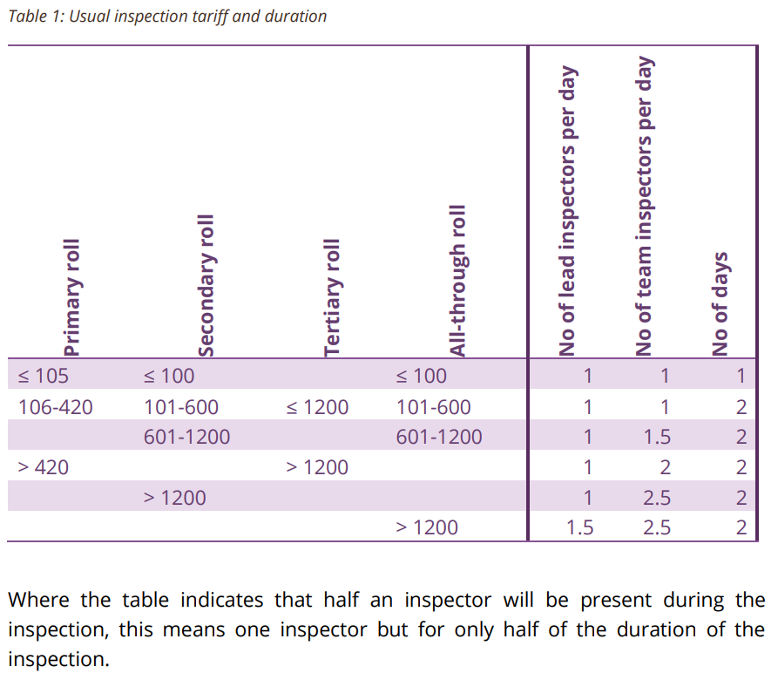
Inspection Tariff & Duration
The table shows the tariff of Inspectors for different size schools
The majority of schools will receive a 2 day Inspection with 1 Lead Inspector and 1 Team Inspector
The number of Inspectors will be adjusted for smaller and larger schools
Page 7 of Inspection Handbook

Slide 14
Notice periods
Lead and Team Inspectors will be told the name of the school to be inspected 10 days before the Inspection
The school will receive 2 days notice of the Inspection

Slide 15
Before the Inspection
Initial Phone Call
Call to Headteacher from Inspection Coordinator or Lead as early as possible and by midday at the latest
Headteacher told name of Lead and Team Inspectors
Inspection Coordinator calls Lead and gives greenlight
Lead Inspector calls School for initial conversation

Slide 16
Initial Phone Call
Pre Inspection Checklist
Team members QA Visitors / Inspectors Shadowing
Reminder of Chair of Governors legal duty to Inform parents that the inspection is taking place – template letter
Inspector Badges – Licence to Inspect / DBS
Record of consultation with parents/carers
Reissue Questionnaires during inspection
Arrange meetings for discussions with key people
Outline the range of observations and evidence gathering that will take place
Lesson observations, work scrutiny and observation of Collective Worship

Slide 17
Initial Phone Call 2
Request School documents in electronic form
School’s Catholic Self-Evaluation Document (CSED)
School Improvement Plan
Attainment and Progress data
Timetables
The Inspection team will already have
Previous Section 50 Inspection Report with Recommendations
Last Estyn Report for the School
Information from GIAS My Local School and School Website

Slide 18
Inspection Rescheduling
There are only a limited number of reasons why the diocese may decide that an inspection may not go ahead
Deferral Policy – Appendix 6
Serious incident – death or serious injury of a pupil or member of staff
School closure to all pupils
At least three quarters of staff will not be in school for half of the duration of the inspection
Senior member of staff under police investigation or a serious concern
Absence of Headteacher will not lead to a deferral

Slide 19
Analysis & Evaluation of CSED
Accuracy of School’s Assessment of Pupils’ progress and attainment
Robustness and accuracy of School’s CSED
Issues for inspection will arise from inconsistencies between CSED and evidence
Also from significant matters omitted from CSED
Lead Inspector will use CSED, data and other information to develop lines of enquiry

Slide 20
Communication during Inspection
On arrival
Inspectors will meet with Headteacher and Leadership team
Tour of school
Brief meeting with staff if possible
Keeping headteacher updated
Team will update the Headteacher during the day and during morning of day 2
Meeting at end of day 1 to discuss findings so far and give school the opportunity to present more evidence on day 2

Slide 21
During the Inspection
Observation of learning
Observation of Prayer & Liturgy
Scrutiny of pupil work
Scrutiny of Parent/ Carer and staff questionnaires
Meetings with
Pupils
Headteacher
Chair of Governors / Link Governor
Subject Lead for RE
Head of Sixth Form
Chaplain and /or Parish Priest
The Inspection Plan
Organised with support of School leaders
Inspectors reserve the right to gather evidence from anywhere in the school during inspection
Schools will be asked for a list of pupils from which to choose for work scrutiny and meetings
Meetings with pupils and Governors should take place without school staff present

Slide 22
Teaching & Learning
There will always be a particular focus on:
Learning & Progress
Behaviour
Quality of teaching
Use of assessment to support learning
Where teaching is evaluated a connection should be made to the impact it has on learners’ behaviour, progress and the quality of learning.

Slide 23
Formal Feedback
Formal feedback must not be given before the end of the final day of the inspection
There should be no surprise to the Headteacher
Maintaining confidentiality until final report is received
Judgements Key grades awarded
What the school does well (No more than 5 points)
What the school needs to do to improve (no more than 3 points)
Whether the school is compliant in every respect
Whether the school has met all areas of improvement from the last inspection

Slide 24
After the Inspection
Report
Draft report sent to diocese within 5 working days after the inspection
Within 10 days after the inspection Quality Assurance by Diocesan Coordinator & QA Reader (Senior Inspector) takes place
Within 11 days – draft report is sent to school for checking of factual accuracy only - one day allowed for this using comments tool in Word.
Within 15 days of inspection Final Report is published as a PDF and sent to Headteacher and Chair of Governors
At the discretion of the diocese the Report will be sent to the Arch/ Bishop and Local Authority

Slide 25
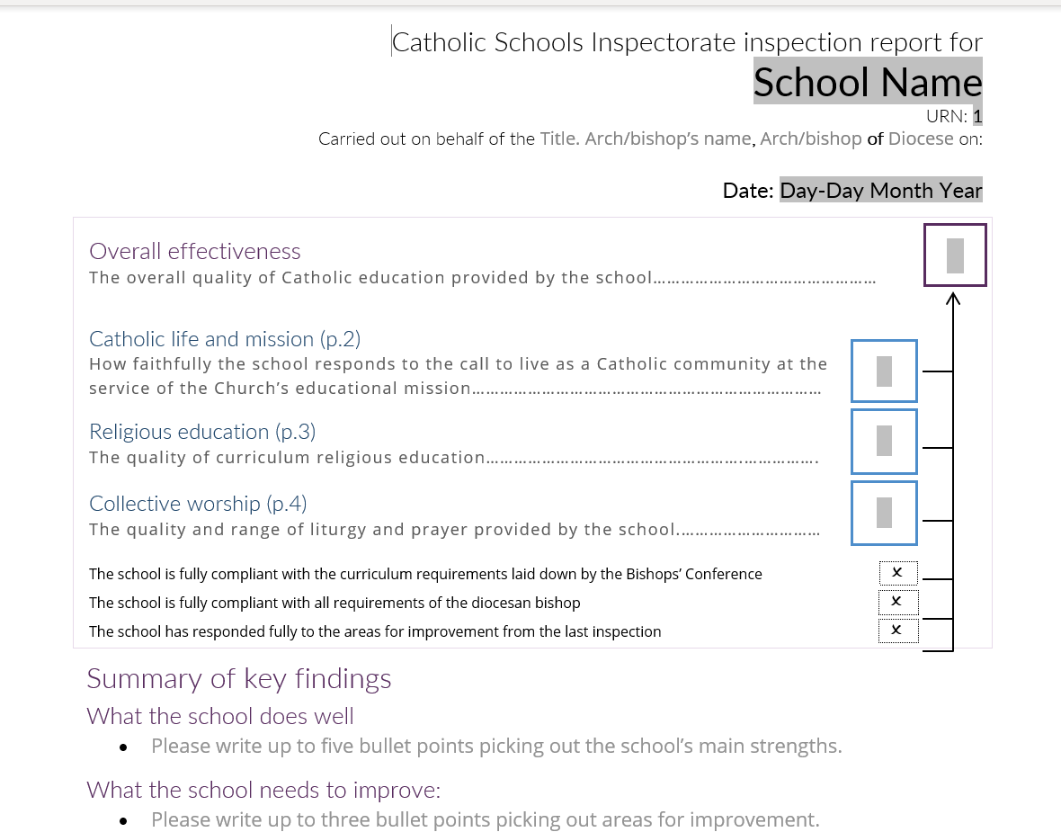

Slide 26
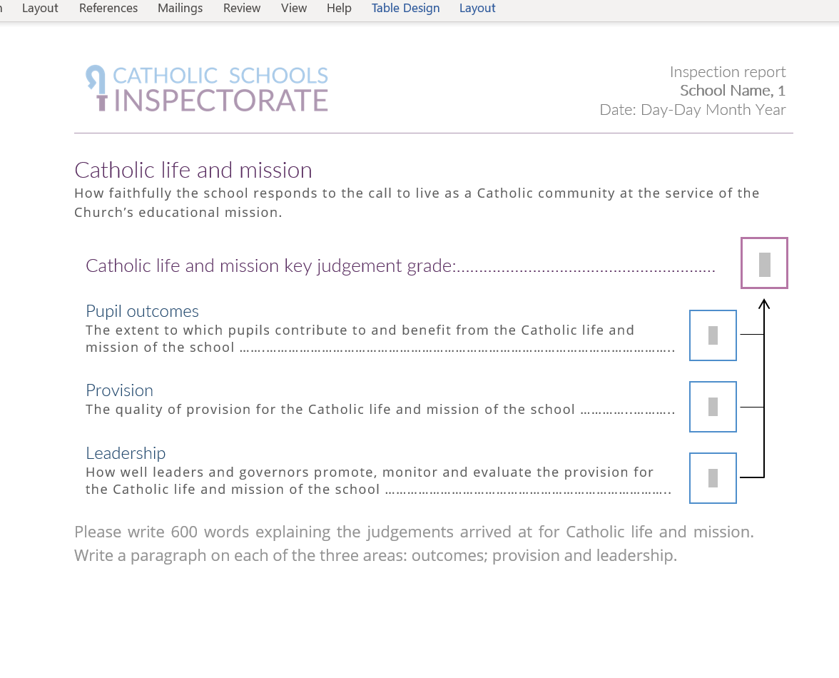

Slide 27
After the Inspection
Post Report Publication
A requirement that the report is published prominently on school and diocesan websites
A copy should be sent to parents/ carers within 5 working days of receipt
A copy of the report is sent to the Arch/Bishop and Trustees
Final report will also be published on diocesan websites and on the CES website

Slide 28
Quality Assurance
QA processes
National QA of Inspector Appointment Process
National QA of Inspector Training Programme
QA visits to 10% of inspections
No Notice QA visits
Further training for Inspectors where required
QA reports on inspection process
QA reader to quality assure reports
Regional and National sampling of reports
Asking schools to write case studies of excellent practice to share good practice and achieve consistency is being considered

Slide 29
Quality Assurance
QA process
QA will ask the Lead for all documentation and data sets provided the afternoon before the inspection including CSED
QA will also look at school website for policy documents and published curriculum materials in relation to Catholic life and Mission, Religious Education and Collective Worship
QA will check that Lead has followed all procedures and protocols and that the pre inspection analysis reflects all the information available

Slide 30
Quality Assurance 2
QA Activities: Observing Inspectors carry out:
Observations of learning, assemblies, prayer and liturgy, meetings and interviews
Review evidence collected during the inspection
Check judgements match the evidence and criteria
Meeting with school senior leaders
QA will write a short report which will be shared with LI at a feedback meeting
A copy of the report will be sent to the Diocesan CSI Coordinator and inspection team
QA of Reports
QA reader’s role is to check the quality of reports against the quality assurance checklist.

Slide 31
Catholic Schools Inspectorate Part 3
Catholic Self Evaluation Document

Slide 32
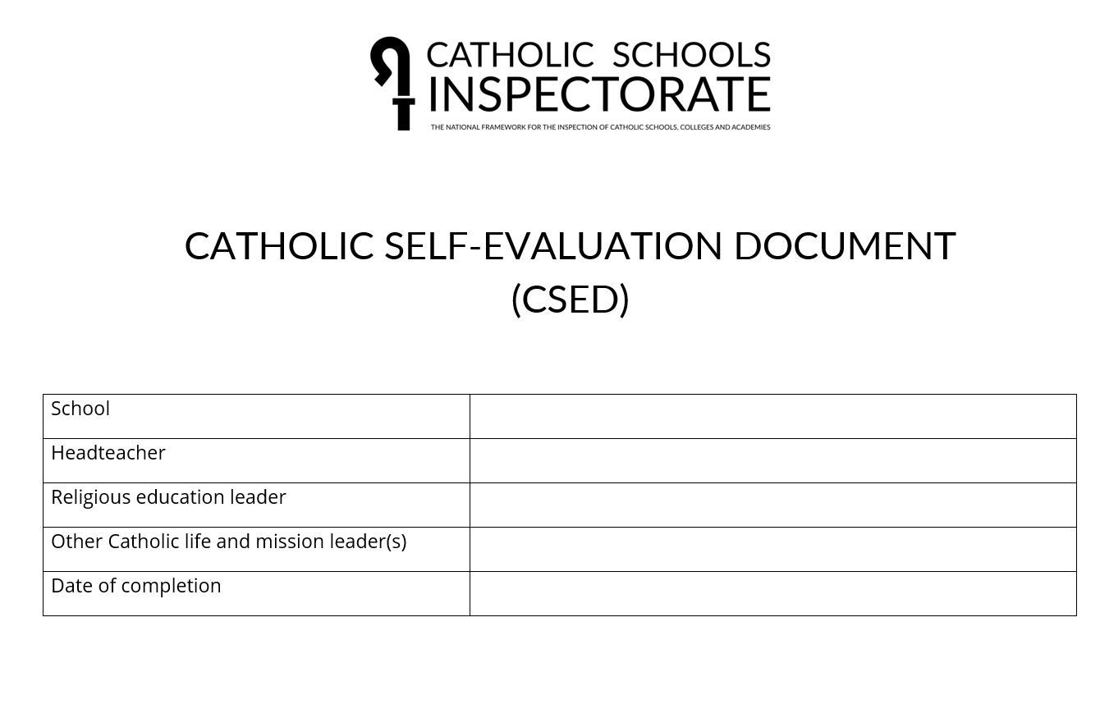

Slide 34
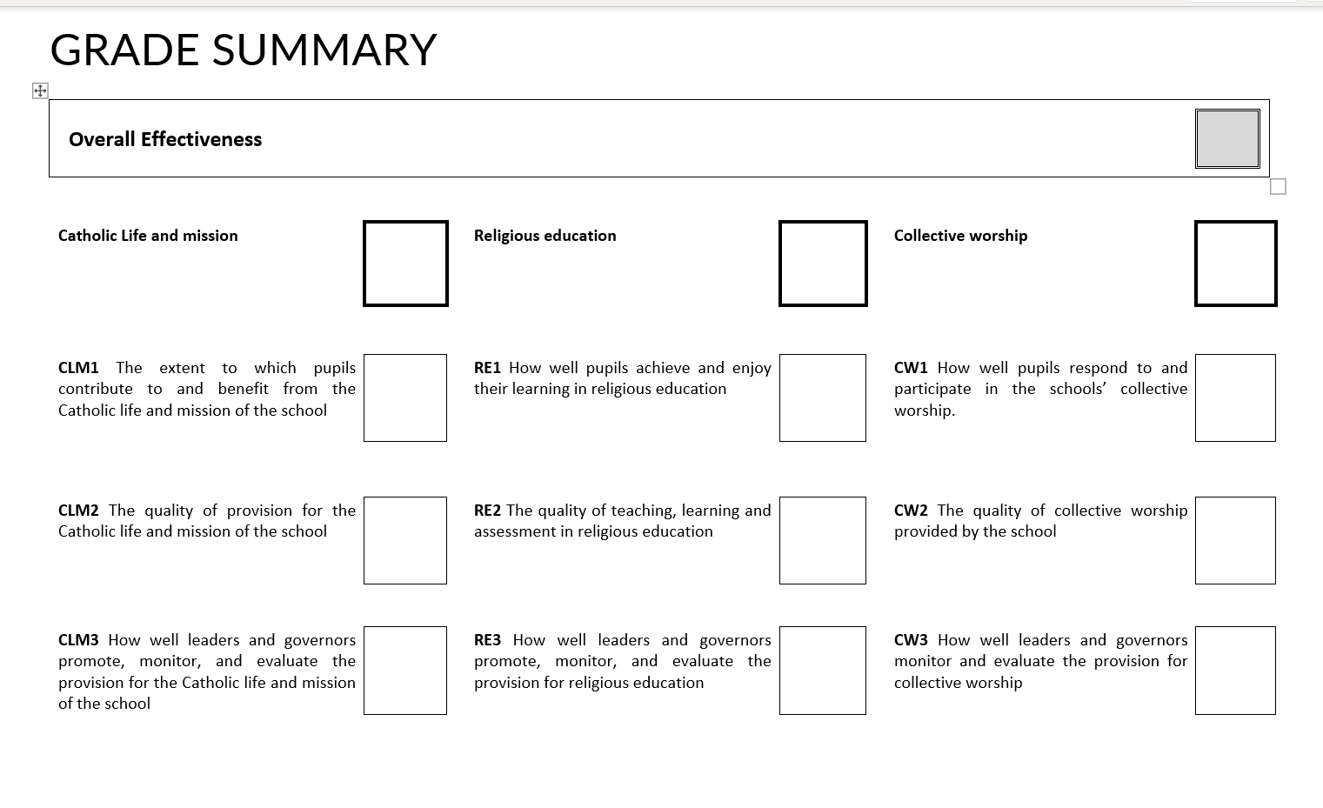

Slide 35
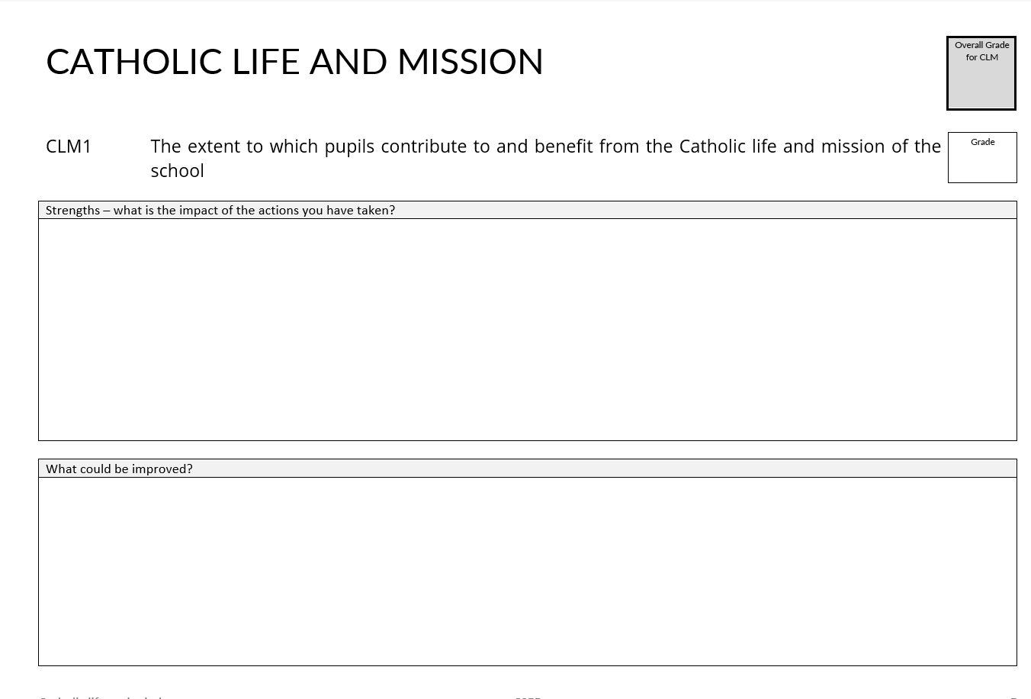

Slide 36
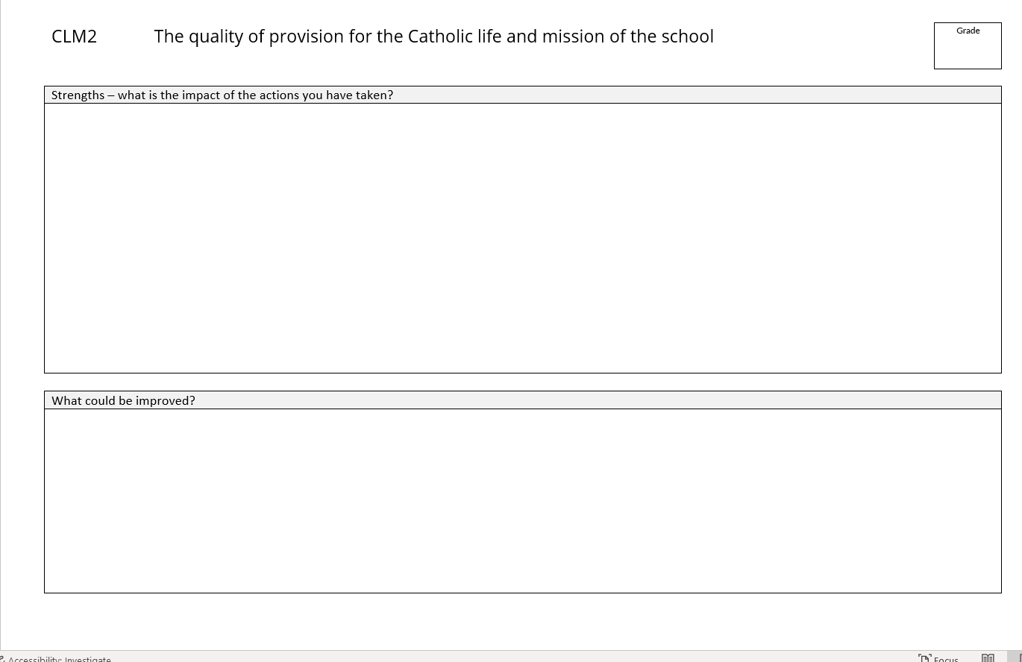

Slide 37
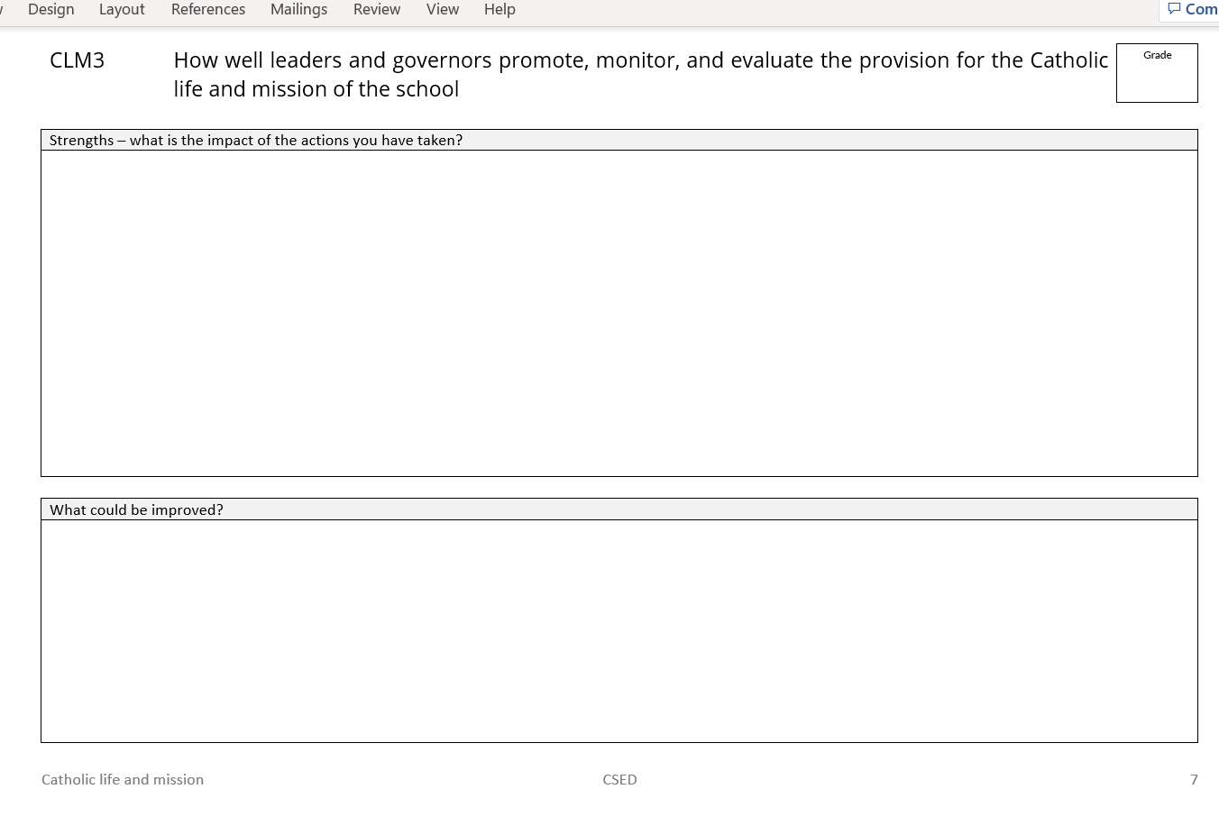

Slide 38
Sections 2 and 3 follow the same process
RE 1
RE 2
RE 3
Collective Worship 1
Collective Worship 2
Collective Worship 3

Slide 39
Information Sections
Pupil and Staff information
Religion Data
Senior Leader Data
Curriculum Information
Capitation information

