Slide 1
Chaplaincy in a MAT Setting
Diocese of Nottingham
Wednesday 14 June 2023

Slide 2
Context
4 Catholic Multi-Academy Trusts established in September 2018.
In September 2022, we moved to 3 Catholic Multi-Academy Trusts.

Slide 3
Vision for Chaplaincy

Slide 4
Structures for Lay Chaplaincy
2018 – 2022
Lead Lay Chaplain
Lay Chaplain / Hub Lay Chaplain
2022 –
Director of Chaplaincy
Lead Lay Chaplain
Lay Chaplain / Hub Lay Chaplain
Job Evaluation Process – implemented in September 2018.
All roles are evaluated using one evaluation tool to ensure consistency across the diocese.
Establishment of diocesan-wide pay scale.

Slide 5
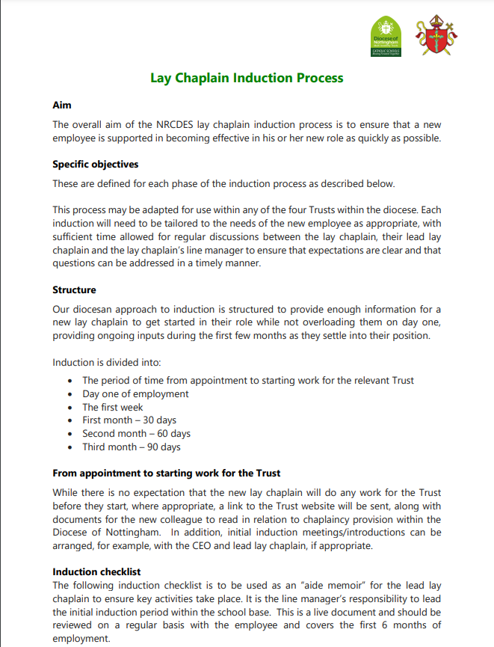
Support for Lay Chaplaincy
Lay Chaplains are employed by the CMATs but are also overseen by the Education Service.
Regular meetings with Director of Chaplaincy / Lead Lay Chaplains
Termly INSET day
Annual retreat

Slide 6
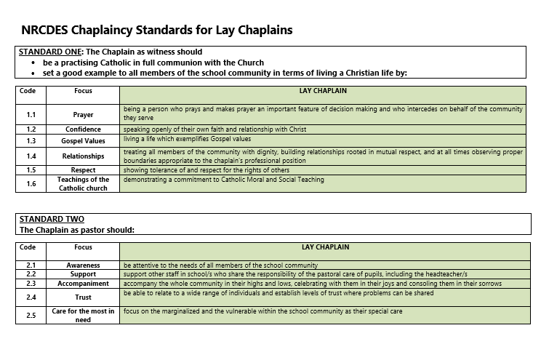
Lay Chaplaincy Standards

Slide 7
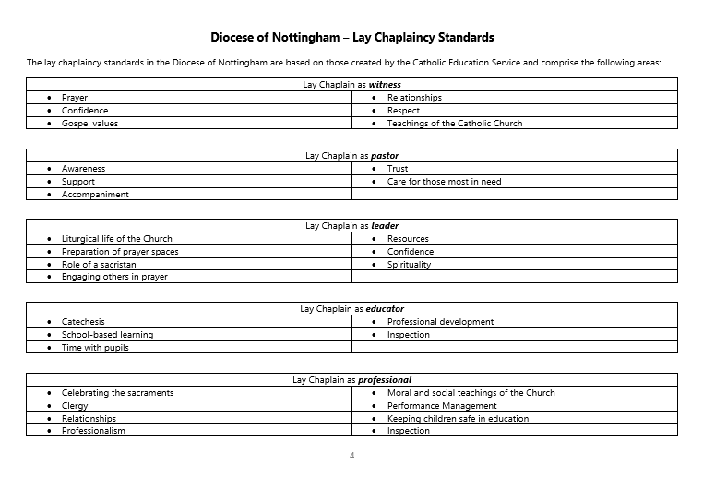
Lay Chaplaincy Standards

Slide 8
Lay Chaplaincy Standards
Lay Chaplain as pastor
Awareness
Support
Accompaniment
Trust
Care for those most in need
Lay Chaplain as professional
Celebrating the Sacraments
Clergy
Relationships
Professionalism
Moral and social teachings of the Church
Performance Management
Keeping children safe
Inspection

Slide 9
Lay Chaplaincy Standards
Now working on standards for:
Apprentice Lay Chaplain (Band 1)
Lay Chaplain (Support Staff) (Band 3)
Lay Chaplain / Hub Lay Chaplain (Band 5)
Lead Lay Chaplain (S1)
Issues:
recruitment and retention – lack of clear pay progression opportunities.

Slide 10
Career Progression
Apprentice Lay Chaplain (Band 1)
Lay Chaplain (Support Staff) (Band 3)
Lay Chaplain / Hub Lay Chaplain (Band 5)
Lay Chaplain / Hub Chaplain (UPS) (Band 6)
Lead Lay Chaplain (S1)
Lead Lay Chaplain (UPS) (S2)
We are now working on establishing an ‘assessment’ process which could be used to gain ‘UPS’ status.

Slide 11
Career Progression
Apprentice Lay Chaplain (Band 1) £20,258 - £20,812
Lay Chaplain (Support Staff) (Band 3) £21,968 - £23,194
Lay Chaplain / Hub Lay Chaplain (Band 5) £27,852 - £31,099
Lay Chaplain / Hub Chaplain (UPS) (Band 6) £32,020 - £35,411
Lead Lay Chaplain (S1) £36,298 - £40,478
Lead Lay Chaplain (UPS) (S2) £41,496 - £45,495
We are now working on establishing an ‘assessment’ process which could be used to gain ‘UPS’ status.

Slide 12
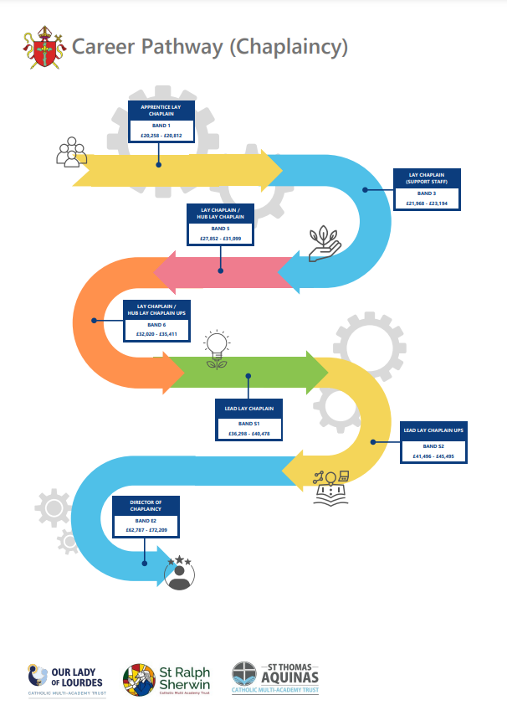
Career Pathway for Chaplaincy

