Slide 1
How to make a simple Easter garden. Find a seed tray, and fill it with soil.
Lat Blaylock
RE Today

Slide 2
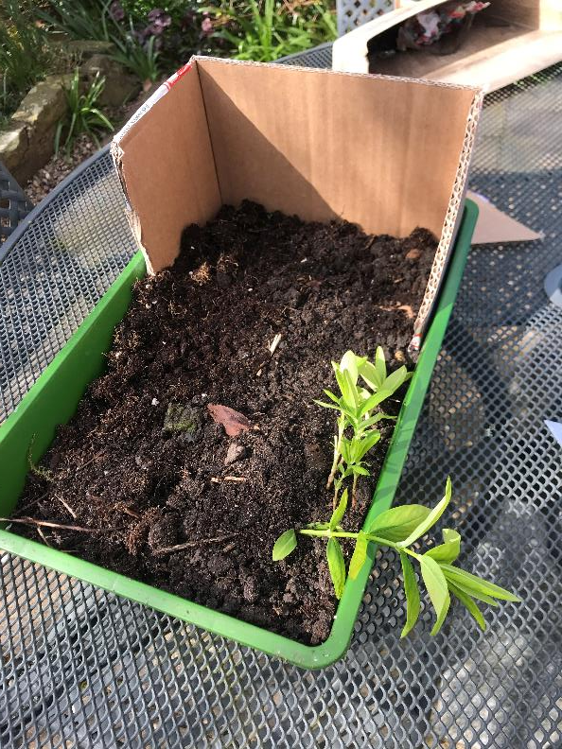
Box cardboard cut to make a hill
Easter Gardens show the story of Good Friday and Easter Sunday, with as much detail as you can think to include.
If you put a cardboard end in the tray, and make it firm with soil on top, you can build a hill for the cross and empty tomb
Seed tray

Slide 3
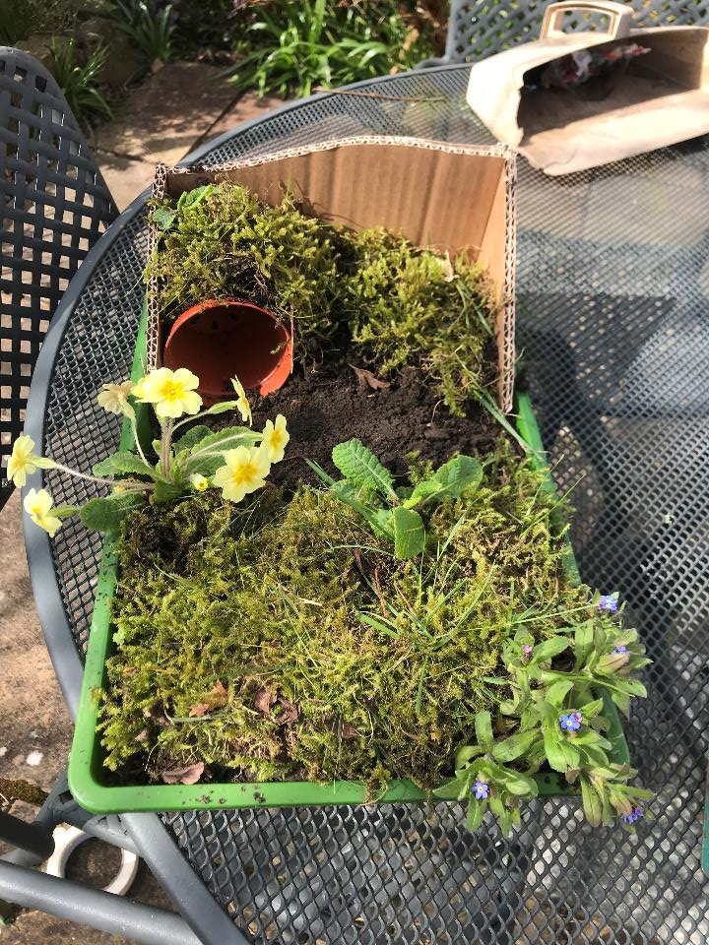
Flower pot
I’ve used a flower pot for the grave of Jesus, and covered it with soil, and I found lots of moss in the garden – do ask about what you can use.
I put a forget-me-not plant and a primrose in my garden. I hope they will actually grow.

Slide 4
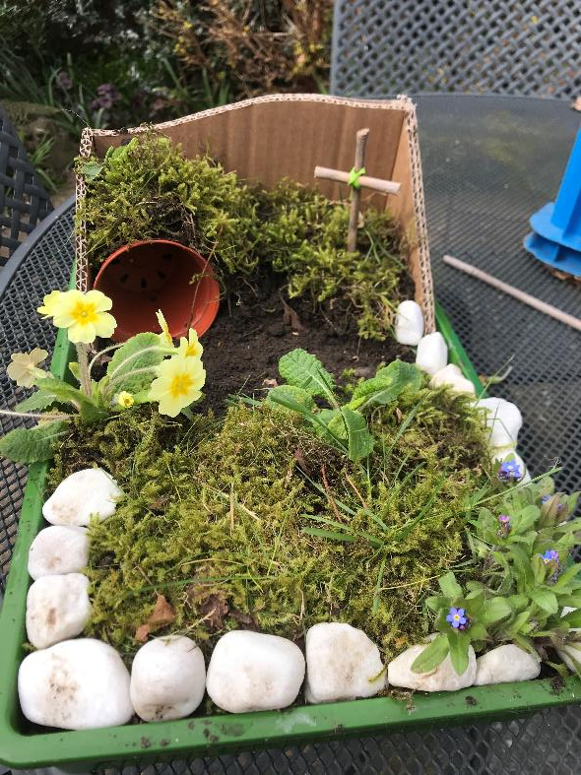
Cross
I found some white stones to make a border round the garden, and made a little cross out of two sticks. Some people put three crosses in their garden, but I’ve just put one.

Slide 5
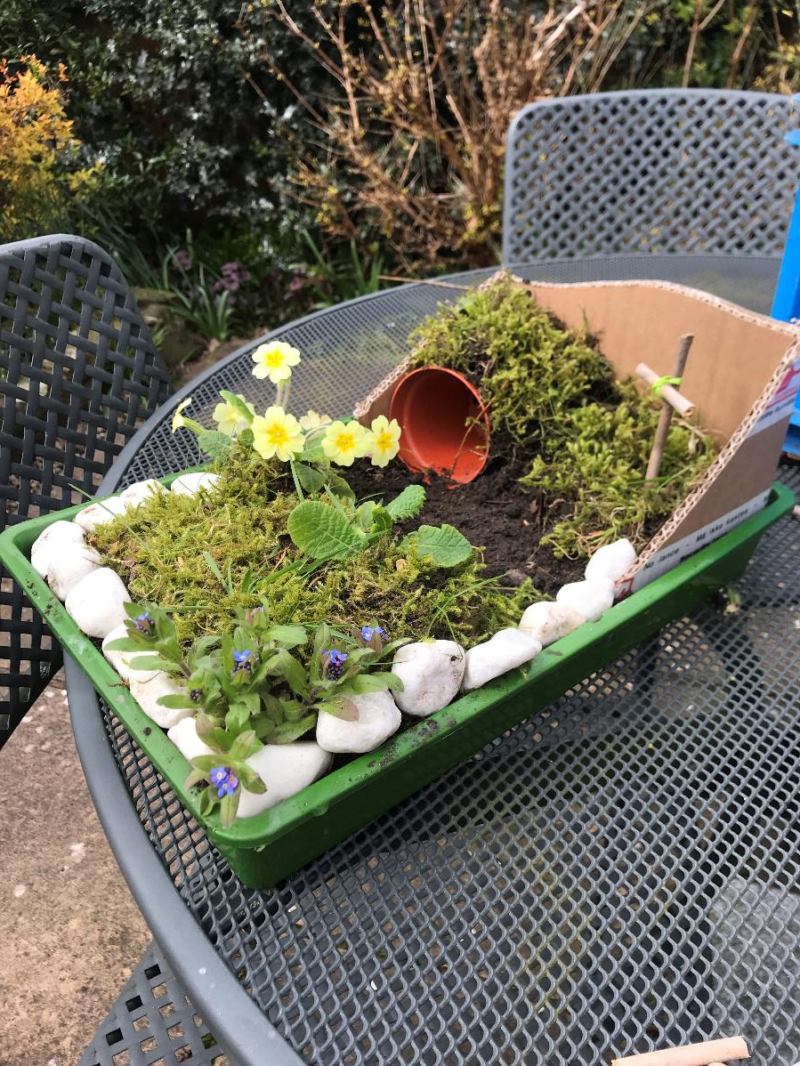
Next I had a think about how to show the story of the first Easter Sunday. I went to find some gravel to make a pathway in front of the tomb.
Other people can do this with whatever you can find: every Easter Garden is different.

Slide 6
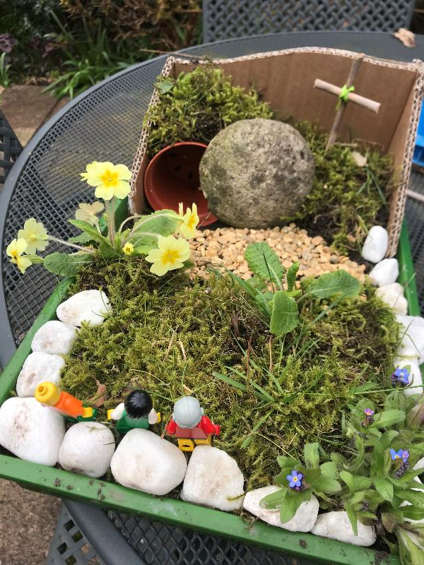
I made a gravel path, and found some lego figures to show the story of the first Easter morning.
While it was still dark, a long time before dawn, the women came to the garden. They were worried about who would move the stone, but they saw that it had already been rolled away.
I was pleased with the big round stone I found in the garden.
Three friends of Jesus came at sunriseel

Slide 7
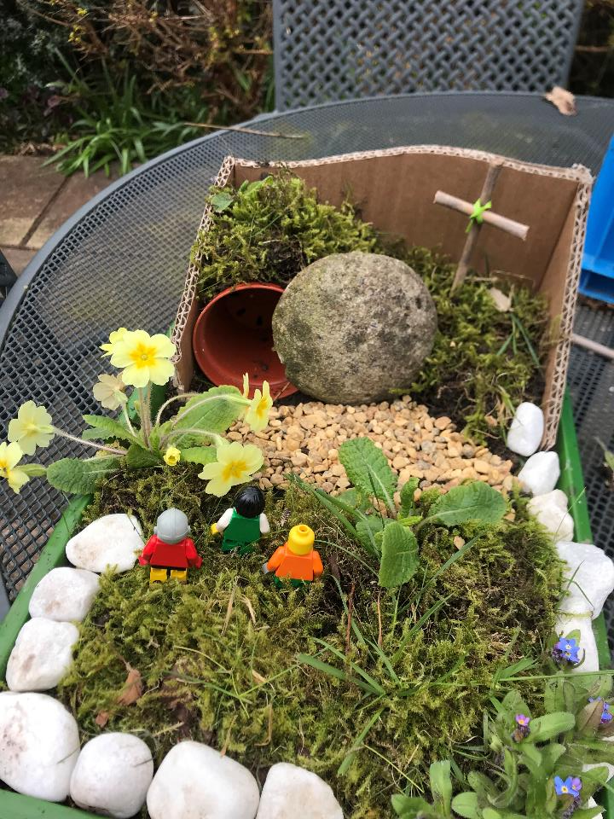
As the women came closer, I wonder how they were feeling?
I think they were still very sad because of what had happened to Jesus.
But they wanted to do what they could.
As they came closer, they wondered why the stone had moved

Slide 8
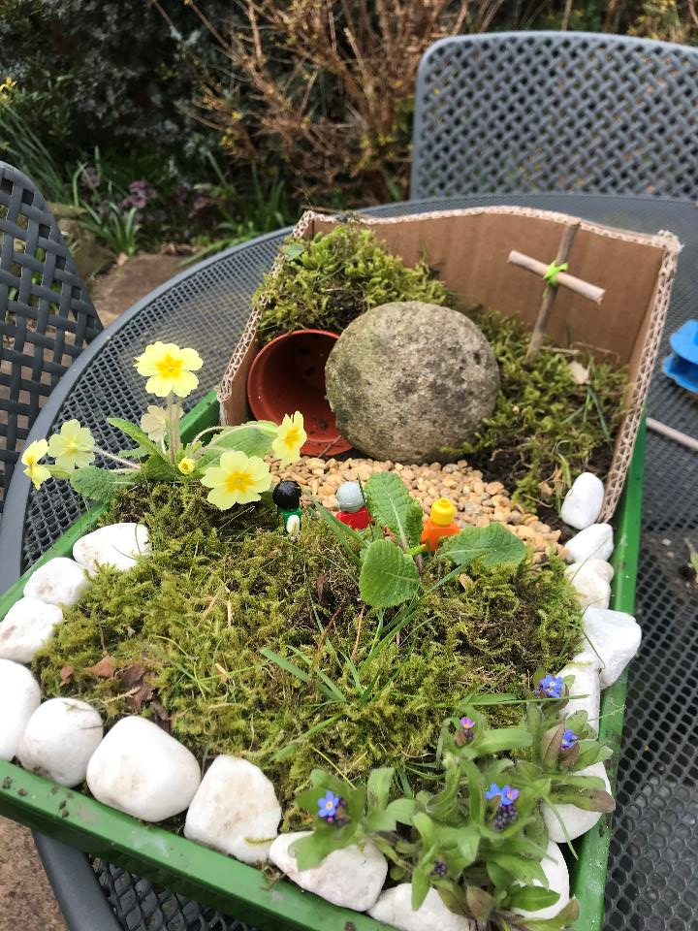
When they got near enough to the tomb, they could see that the body of Jesus was not inside.
They still did not know what was going on, and could not guess the good news.

Slide 9
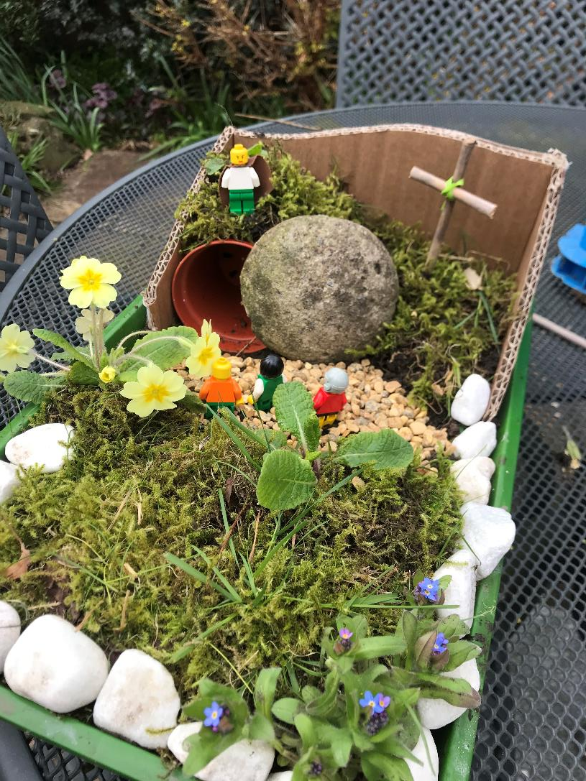
Angel
As they stood there, they saw a young man dressed in white, who spoke to them.
“Why are you looking in a graveyard for someone who’s alive? Jesus isn’t here. He has risen. Go and tell the disciples.”

Slide 10
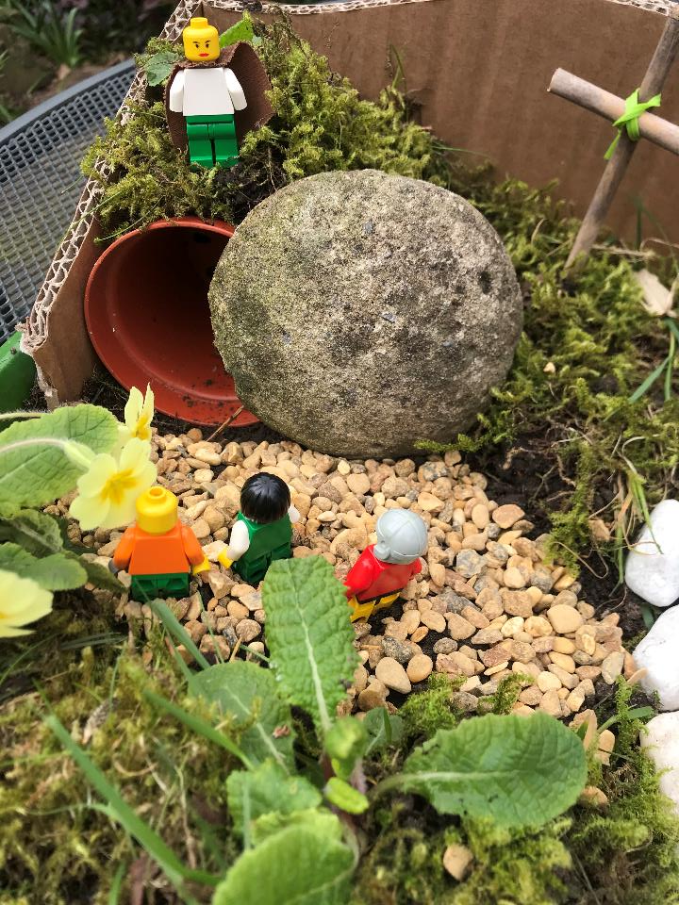
Why do you look for one who lives in a graveyard? He is risen.
Mary and her friends were amazed. They could hardly believe it.
Risen? What did the angel mean? (If it was an angel)

Slide 11
What extras can I add to my garden, and how can I tell some more of the story?
If you make an Easter Garden make sure you get aphoto to send to your teacher
The women were amazed and surprised…

Slide 12
Lat Blaylock RE Adviser

